Slide 1
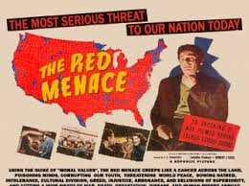
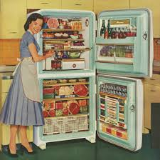
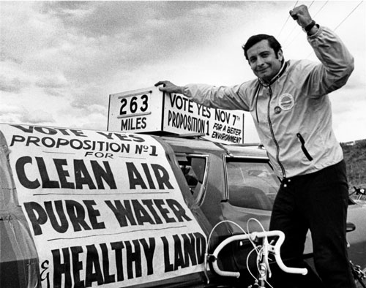
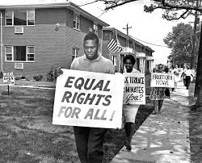
Domestic Affairs 1950-1975
Red Scare, Mass Culture, Civil Rights and Social Movements

Slide 2
The Red Scare ‘Round Two’
Background information:
Influenced by the First Red Scare (1917-20)
Communist party in the US grows (peak of about 75,000 in 1940-41)
Successful in organizing labor unions and opposing fascism (remember USSR our ally during WW2)
World Affairs after WW2 causes the US to resume fears about communism
Examples: Soviets tested an atomic bomb in 1949, Communist take over China in 1949, Korean War 1950…
Joseph McCarthy makes a speech on Feb. 9th, 1950 claiming to have a document that he said was a list of known Communists working for the State Department.
Why did the 2nd Red Scare Begin after WW2?
Foreign Policy and World Affairs raised tension between the Soviets & the US
Growth of radical politics during the Great Depression made Americans made the fear of Communism seem imminent

Slide 3
Cold War at Home How did fear of domestic Communism affect American society during the Cold War?
Anti-Communist Policy
Effects on the Rights of Citizens
What impact did Anti-Communist Policies have on American society?
Creates an Atmosphere of fear that snowballs over time so that Americans are accusing other Americans of ‘communist’ behavior.
This fear leaks into everyday life and encourages the conformist characteristics of the 50s and early 60s
Federal Employee Loyalty Program
The Smith Act
House Committee on Un-American Activities (HUAC)
McCarthyism
3,000 people fired
Unlawful to teach or advocate for the overthrowing of the US gov’t
Investigates possible subversive activities, communists in all aspects of American life
Blacklisting of entertainment figures suspected of having communist ties
People lose jobs and reputations due to accusations

Slide 4
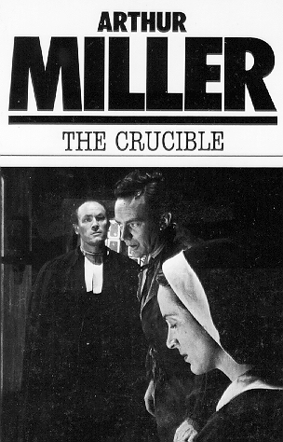
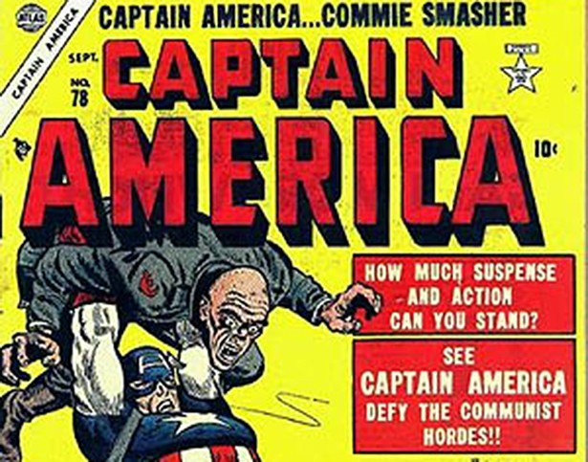
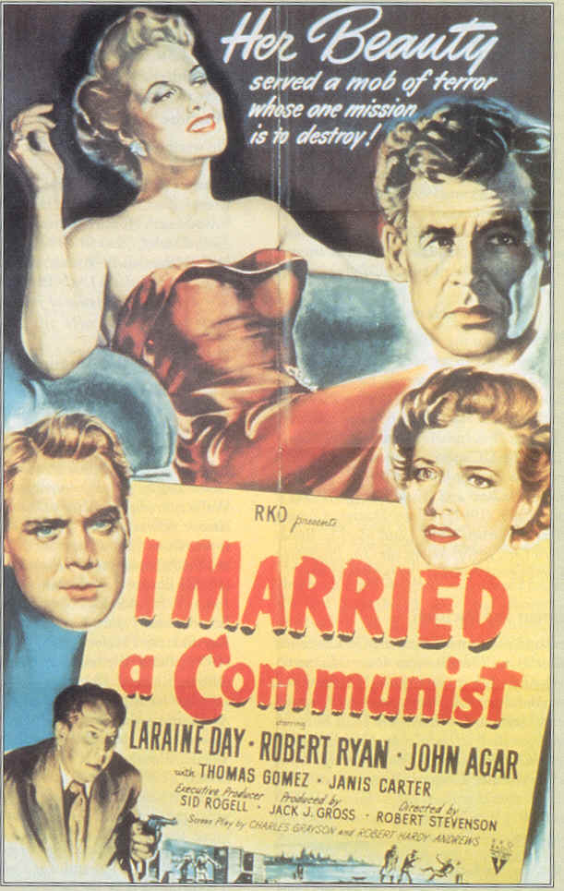
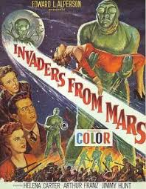

Slide 5
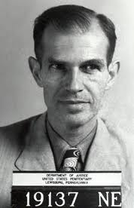
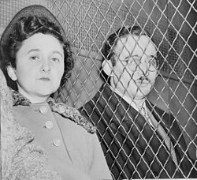
Actual Spies…? Alger Hiss and the Rosenbergs
Alger Hiss
Rosenbergs
Accused of Stealing government Documents
Tried for Perjury
Found guilty and sentenced to five years in prison
Accused of passing on atomic secrets
Found guilty and sentenced to death
From the poor lower east side of Manhattan
Both: Spy trials that illustrate the threat to the nation posed by communist agents, from which mass hysteria and fear gripped the nation.
This case made Congressman Richard Nixon famous as he tacked down ‘secret Communists of the New Deal’
There is still controversy on if Hiss and Ethel were guilty…

Slide 6
McCarthyism
- Demagoguery -
Discussion Questions:
Demagoguery is a political idea in a democracy that appeals to the emotions, fears, prejudices, and ignorance of the people in order to gain power and promote political motives.
Demagogues usually oppose deliberation and advocate immediate, violent action to address a national crisis; they accuse moderate and thoughtful opponents of weakness
Is US Society vulnerable to kind of demagoguery?
Did McCarthyism & Demagoguery perish with Joseph McCarthy?

Slide 7
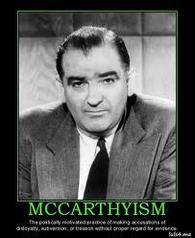
McCarthyism
Define
MCCARTHYISM - The politically motivated practice of making accusations of disloyalty, subversion, or treason without proper regard for evidence
Joseph McCarthy was elected as a US Senator for Wisconsin in 1947. 3 years later he produced a document that he said was a list of known Communists working for the State Department. Ultimately, he was unable to back up his claim and died, discredited, at the age of 49 in 1957.

Slide 8
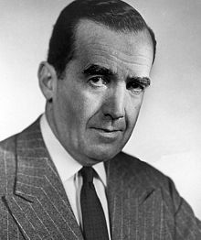
The End of the Second Red Scare
Supreme Court Cases
Watkins v. US
Curtailed the power of HUAC to punish uncooperative witnessed by finding them in contempt of Congress (what the Hollywood Ten went to jail for)
Example: Slochower v. Board of Education
Slochower was a professor who had been fired for invoking his 5th amendment rights when asked if he had been a member of the communist party in the past. The court found that invoking the 5th is not an admission of guilt or presumption of perjury
Outspoken Individuals
Example: Edward R. Murrow spoke out against McCarthyism on his TV show See It Now
Resulted in a backlash against McCarthy
http://www.youtube.com/watch?v=anNEJJYLU8M

Slide 9
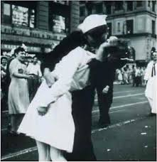
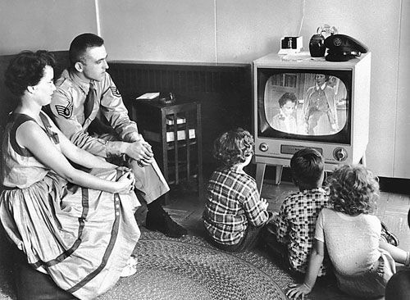
Mass Culture
Economic boom after WW2
Demobilization caused a fear of Joblessness for returning soldiers
Response = GI Bill, which grants veterans benefits
Ex: yr. of unemployment payments, financial aid for college, gov’t loans for building homes & businesses
Effect = increase in home construction, # of college degrees, and population boom (aka the baby boom),
Growth of the Suburbs made possible
Not all good – big increase in prices after WW2
Price controls and rationing has ended
Inflation –
a general increase in prices and fall in the purchasing value of money.

Slide 10
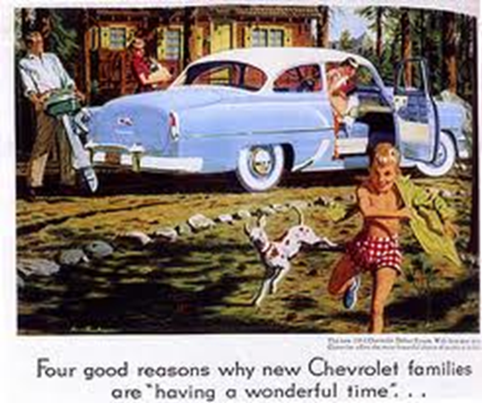
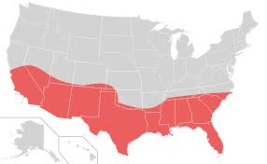
Mass Culture
How did the shift in where Americans live after the 1950s change American Politics?
Southern/western states get more population and this shifts representation in Congress
- The North loses population (deindustrialization) & political power
Social Changes
Suburgatory formed
Levittowns built in in Pennsylvania & New Jersey, affordable homes
Growth of Car industry
Car ownership grows as people commute from the suburbs to work/ drive around suburbs
Interstate Highway Act
Connected cities, boosted travel & vacation industries
Migration of population – south & west
Sunbelt gains population b/c of climate & jobs in defense industries (aerospace & electronics)
Impact: Shift in Political Power (away from urban areas, the Northeast & Midwest)
Interstate High Way =
Allows for the creation of the growth of the suburbs
Need for more cars
Loss of business & population on the rural routes (death by interstate)

Slide 11
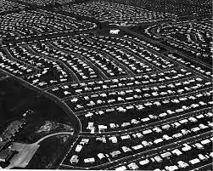
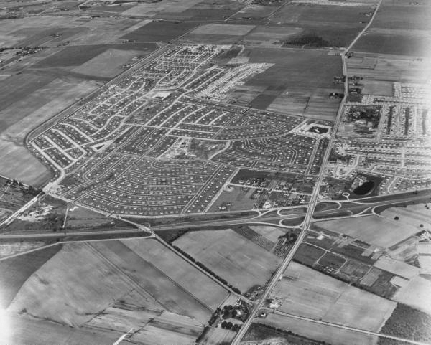
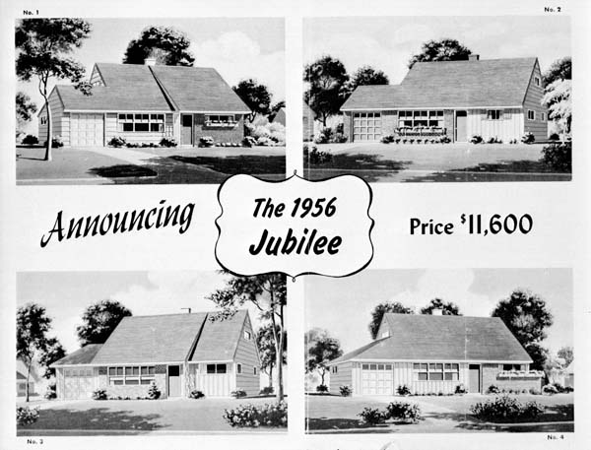
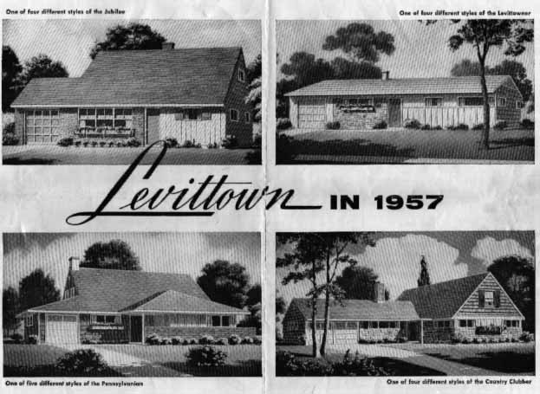
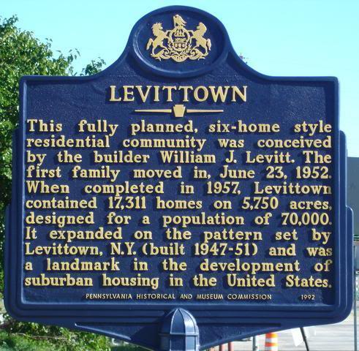

Slide 12
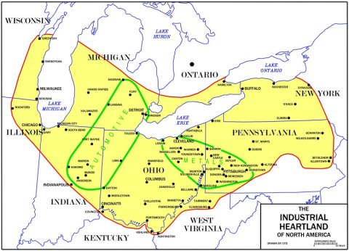
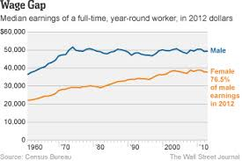
Mass Culture
Economic Changes
Creation of a Post-industrial society
Service sector jobs – law, healthcare, retail, banking…
Growth of Information industries (white-collar jobs)
Decrease in Manufacturing Jobs eventually contributed to rustbelt development (70s-80s)
Agricultural work decreased (currently less 1% of US pop.)
Women in the workforce
Number double between 40-60
New types of businesses
Franchise businesses
Quality & sameness… yeah for Subway
Multinational corporations
Companies that produced & sold services in many countries around the world (GM, IBM, Coca Cola…)
How did the Types of Jobs Americans were employed at change after the 1950s?
Deindustrialization creates the ‘Rustbelt’
A decrease in industrial/ manufacturing jobs and in increase in service jobs and a growth of “Multinational corporation”
*Post – Fordist = the idea that economies have moved away from large scale mass production in factories
Economies now based on service industries or small flexible manufacturing

Slide 13
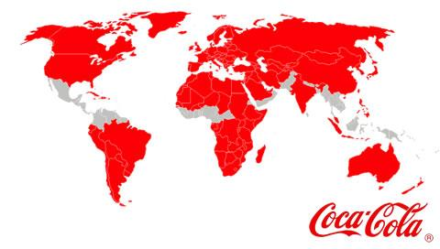
Multinational Corporations

Slide 14
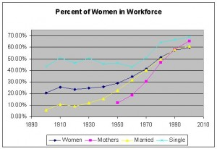
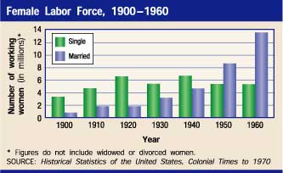
How does the role of women change after ww2?
- more women enter and stay in the work force
Gives women more spending power & a shift in the pre-war gender roles begins to occur
Culturally this sets the stage for the feminist movement for the 60s and 70s

Slide 15
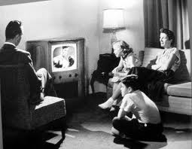
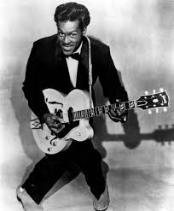
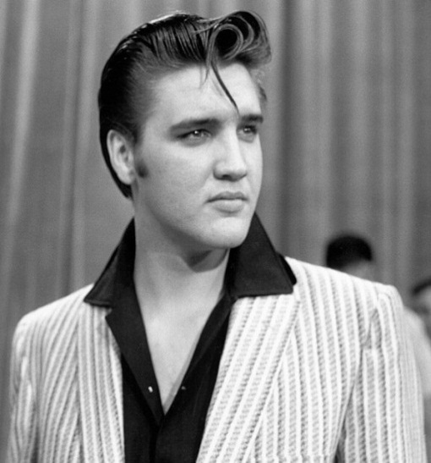
The Culture of Consumerism
How did the technological advancements of the 1950s help create a culture of consumerism?
New tech products are in demand because they save time & labor
Consumerism
Consumerism - social and economic order and ideology that encourages the acquisition of goods and services in ever-greater amounts
American spend more $, much on credit
Technology items in demand
TVs, washing machines, refrigerators…
Rock-and-Roll
Rock originated in African-Americans neighborhoods (rhythm and blues) and diffuses north with migration & adoption by white artists

Slide 16
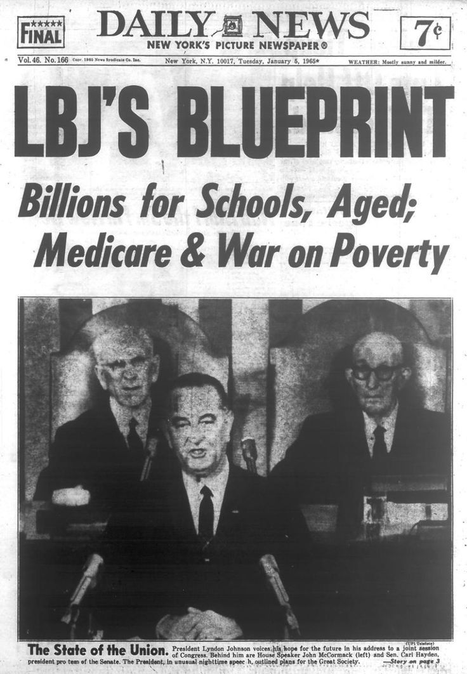
The Great Society – LBJ’s Domestic Policy “the War on Poverty”
1964 - Series of laws & programs meant that were intended start “an end to poverty and racial injustice”
Medicare = provides basic hospital insurance for older Americans
Medicaid = provides basic medical services to poor and disabled
Also included legislation providing $ to poor schools, and 1965 laws eliminating the quota system for immigration.

Slide 17
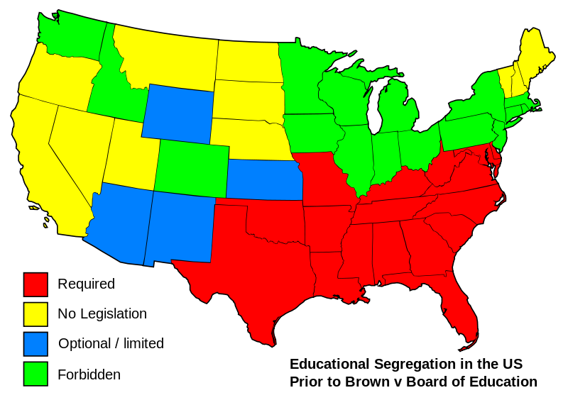
Important Starting Points
Legal Cases on Segregation
13th, 14th, 15th Amendments (1865-1870) free the slaves, give equal rights to African Americans, & prohibited discrimination in Voting
Plessy v. Ferguson (1896) Supreme Court Case upholding the constitutionality of state laws instituting racial segregation. “separate but equal”
Brown vs. Board of Education (1954) SC case overturning “Plessy”, making segregated schools illegal.
What is the difference between de facto and de jure discrimination?
De facto – segregation enforced through public pressure, customs, zoning, and realtor practices.
De Jure – segregation enforced by law
Vocabulary:
- de facto discrimination unfair treatment of someone that is a matter of custom but not based in law
- De jure discrimination unfair treatment of someone that is based on laws

Slide 18
Desegregation Question:
Time Periods in The Civil Rights Movement:
How does the Civil Rights Movement change over time?
1940s - Federal and Private changes (Ex: Desegregation of the Armed Forces), starts the growth of organizations
1950s - Nonviolence to achieve equality
1960s – More Radical organizations evolve b/c of slow progress and deaths of some leaders
1940’s – Major Federal and Private changes spur’s people to organize
1950s’s – Turbulent time that produce Federal laws that motivate grass roots activism but contrast with little State enforcement
*(Nonviolence era) the movement gained a moral high ground from which any opposition was exposed for its lack of basic human decency
1960’s – Very Turbulent Times – Civil Rights organizations evolve as slow enforcement and violent backlash splits the movement as it gains and loses significant leadership
States vs. Federal power
Federalist vs. Anti-Federalist
Civil War
Does the Federal Government have the power to tell the States what laws they must follow? Sound familiar?

Slide 19
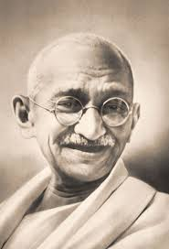
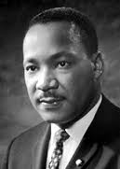
Six Principles of Nonviolence
Nonviolence is not passive, but requires courage
Nonviolence seeks reconciliation, not defeat of an adversary
Nonviolent action is directed at eliminating evil, not destroying an evil-doer
A willingness to accept suffering for the cause, if necessary, but never to inflict it
A rejection of hatred, animosity or violence of the spirit, as well as refusal to commit physical violence
Faith that justice will prevail

Slide 20
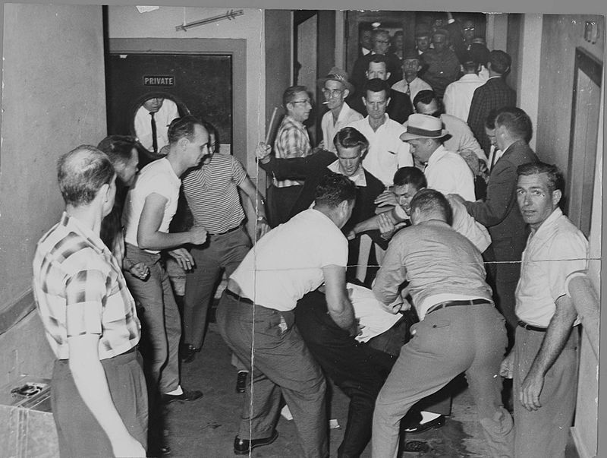
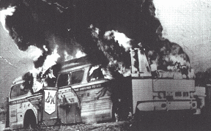
Major Civil Rights Groups
“The Big Four”
CORE – Congress of Racial Equality
- Freedom Rides, Desegregating Chicago’s Schools
- 3 CORE activists killed by KKK during ‘Freedom Summer in 1964’
*Their disappearance is widely publicized… (Mississippi Burning)
A mob beats Freedom Riders in Birmingham. This picture was reclaimed by the FBI from a local journalist who also was beaten and whose camera was smashed.

Slide 21
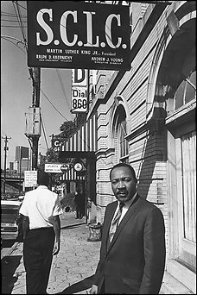
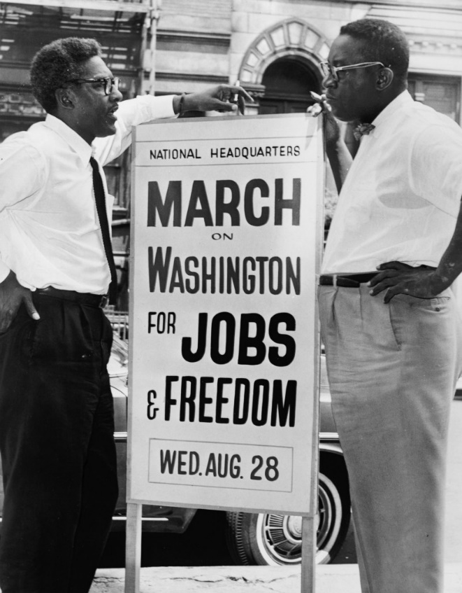
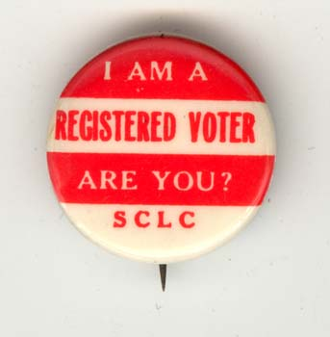
Major Civil Rights Groups
“The Big Four”
SCLC – The Southern Christian Leadership Conference
- First President is Martin Luther King Jr.
- Big role in Civil Rights Movements involved in Albany movement, Birmingham Campaign, St. Augustine protests, Selma Voting Rights campaign & March on Montgomery

Slide 22
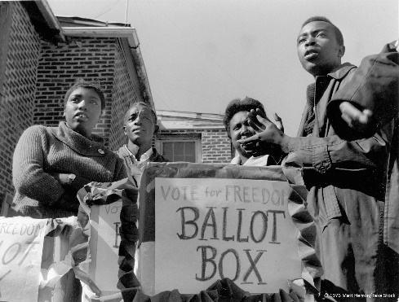
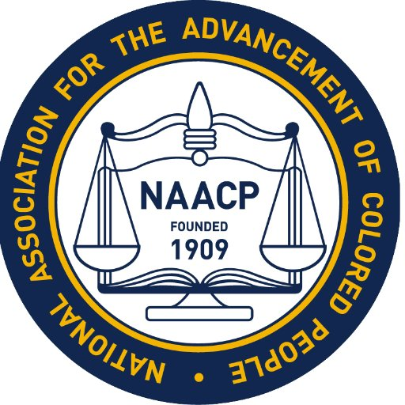
Major Civil Rights Groups
“The Big Four”
SNCC – Student Nonviolent Coordinating Committee
Large organization with many supporters in the north who raised funds for work in the south.
Many sit-ins, freedom rides, Mississippi Freedom Summer and Mississippi Freedom Democratic Party
NAACP – National Association for the Advancement of Colored People
Legal defense fund, Desegregation legislation…
"to ensure the political, educational, social, and economic equality of rights of all persons and to eliminate racial hatred and racial discrimination".

Slide 23
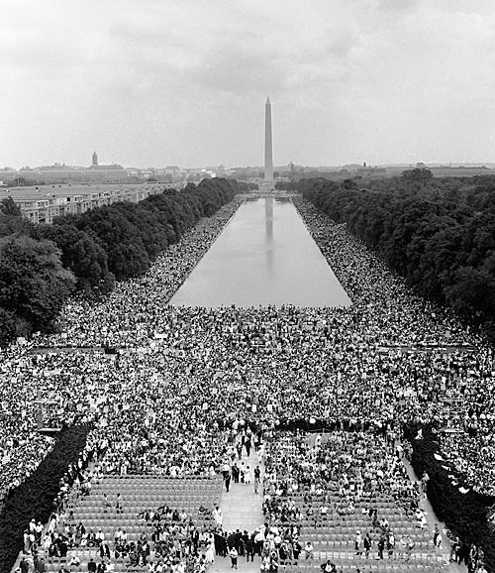
March on Washington
held in Washington, D.C. on Wednesday, August 28, 1963.
The purpose of the march was to stand up for civil and economic rights for African Americans
The march is credited with helping to pass the Civil Rights Act of 1964
- CORE, SNCC & NAACP all organized Freedom Summer and the March on Washington
https://www.youtube.com/watch?v=3vDWWy4CMhE

Slide 24
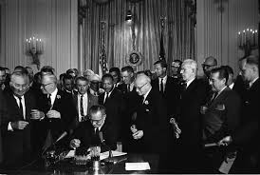
The Civil Rights Movement How did African Americans challenge segregation after WW2?
Civil Rights Act of 1964 –
a landmark civil rights and US labor law in the United States that outlaws discrimination based on race, color, religion, sex, or national origin.
Voting Rights Act of 1965 – banned literacy tests
24th Amendment – banned poll tax
1947 – Jackie Robinson becomes first African American to play in Major League Baseball since 1898
1950: Sweatt v. Painter, McLourin Case (challenges Plessy – separate but equal at collegiate level)
1954: Supreme Court Brown vs. Board of Ed.
1955: Montgomery Bus Boycott, Emmitt Till Murder
1956: SC rules Montgomery, Alabama city law segregating buses unconstitutional
1957 President Eisenhower send federal troops to Little Rock to enforce SC’s decision, Civil Rights Act of 1957
1960: Dr. King and his philosophy of nonviolent protest are elevated within the civil rights movement

Slide 25
Civil Rights Movement Primary Source Activity
Main Idea:
Group Discussion
James Farmer – Freedom Rider
Hank Thomas – Freedom Rider
Edward Rodman – Sit in for Equality
Dr. Martin Luther King Jr. – from Birmingham Jail
What Tactics were used by individuals and groups during the Civil Rights Era?
How did these tactics conform to the principles of nonviolence?

Slide 26
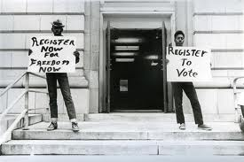
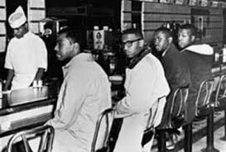
1957 – 1960 Nonviolence
What tactics were used to Challenge segregation after WW2
1. Nonviolence used by leaders of the movement:
Tactics: boycotts, sit-ins, and protests
2. Court Cases to challenge De Facto Segregation
3. Voter Registration (increase political participation)

Slide 27
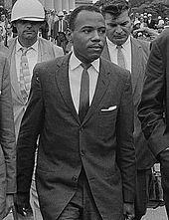
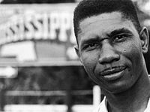
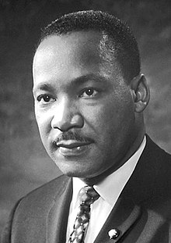
Impact of the 1950s Civil Rights Era
Desegregation of Southern Schools & attacking Jim Crow Laws
Ex: James Meredith, civil rights activist who started the desegregation of Southern Universities (Ole Miss 62’)
But several leaders are also assassinated
Ex: Medger Evers, NACCP activist who worked to expand voting rights. Killed in 1963
Ex: MLK, killed in 1968

Slide 28
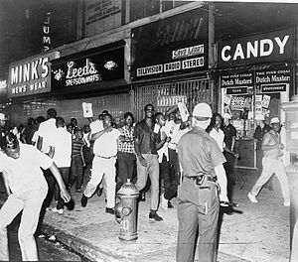
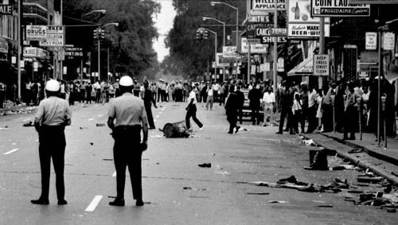
Slow Progress
1964 – 1965 a series of Riots break out in cities across the US
EX: The riots began in Harlem, New York following the shooting of fifteen year-old James Powell by a white off-duty police officer
Kerner Commission: established to figure out the causes of these riots. Blamed discrimination against African Americans
Impact = more radical African American leaders

Slide 29
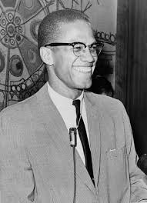
Success and New Challenges
Push for Voting Rights
A. Freedom Summer
B. March in Selma, Alabama
II. Frustration explodes into violence
A. Riots erupt in several cities in 1967
B. Kerner Commission determines main cause of the riots
III. New Voices
A. Malcolm X
B. Black Panthers become symbol of militant groups unhappy about the lack of opportunity and institutionalized racism affecting young people
IV. Martin Luther King, JR.
A. Continued to seek nonviolent methods. Outspoken on Vietnam in the final months of his life
B. King was assassinated in Memphis, Tennessee in 1968
V. Gains and Challenges
A. Legal segregation is eliminated
B. Discrimination continues-Racism remains a part of the American experience, View that rights are a zero sum game continues to interfere with social justice.
Civil Rights Leaders
Stokely Carmichael –
Leader of SNCC & in the forefront of the Black Power movement (60s/70s)
Huey Newton –
1 of the founders of the Black Panthers, advocated more militant civil rights & self defense
Malcolm X –
- Member of the Nation of Islam
Advocated separation of Black & White America
Leaves the Nation of Islam & becomes more open before his assassination
Black Power Movement
- Had a range of Goals from defense against racial oppression to the establishment of social institutions to the creation of self-sufficient economy

Slide 30
The Modern Civil Rights Movement
The focus of the movement turned toward the employment and income gap.
Affirmative Action- Established by the courts, enforced by the Federal Government. The Nixon Administration pushed polices that promoted Affirmative Action.
-Other minority populations motivated to see enforcement of rights - Native Americans
- Latino Americans
- Women

Slide 31
What is the Legacy of the Civil Rights Movement?
Some Achievements but the movement does not reach all of it’s goals (especially the economic goals)
Civil Rights movement becomes the template for the later social/ political movements of the 60s & 70s (Anti-war, Latino movement, AIM, etc…)

Slide 32
Social Movements of the 60s-70s

Slide 33
SNCC Statement of Purpose
On what would a nonviolent social order rest?
How does integration relate to that social order?
What can nonviolence bring about?
How does nonviolence bring about those realties?

Slide 34
Tactics of the Movement

Slide 35
Civil Rights Timeline
Truman – July 26th 1948 Desegregation of the military
_________________________
1948

