Slide 1
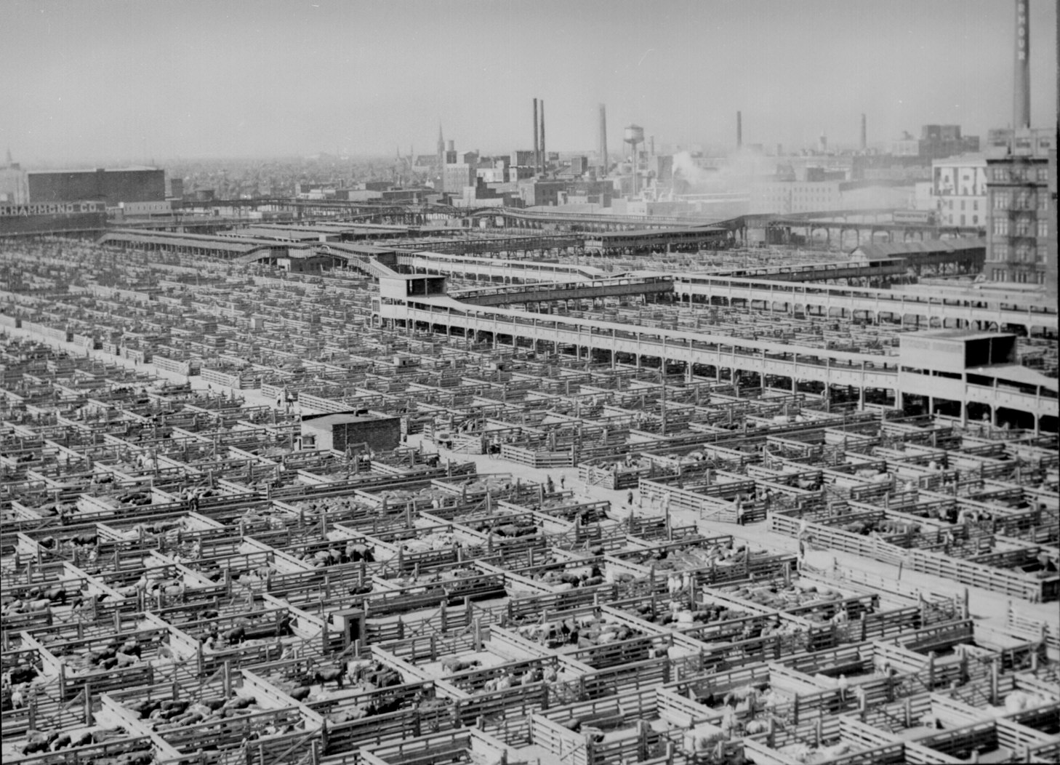
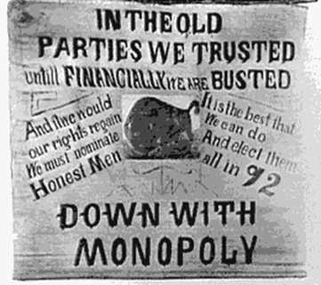
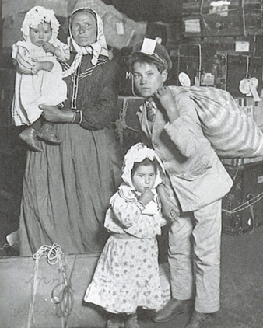
Immigration, Industrialization, and Progressivism
Essential Questions:
Immigration
Why do Immigrants come to The United Stares and what impact did they have upon society?
What was life like for Immigrants in the US during the 19th century?
Industrialization
How did Industrialization and new technology affect the economy and society?
How did big business shape the American economy in the late 1800s and early 1900s?
Progressivism
How did Progressivism change politics and society in the 19th century?

Slide 2
Immigration
1840 - 1914
Essential Questions:
Why do Immigrants come to The United Stares and what impact did they have upon society?
What was life like for Immigrants in the US during the 19th century?

Slide 3
Immigration
Quick Questions:
What percent of United States citizens are immigrants or descended from immigrants?
- 99.9%
What is the longest unfortified border in the world?
- Canada and the United States
What ethnic group do Americans claim more than any other as their primary ancestry on the US Census?
- German… with Irish a close second

Slide 4
Immigration to the United States
Three Phases of Immigration to the United States
  First Wave – Colonial Period 1600s – 1700s
    English/ Scots Irish Immigrants
      Family immigration first in New England (largest population growth during colonial period)
  Second Wave – 1840s – 1920s
    1840s – 1870s = Irish & German Immigrants (Northern European)
      Irish = Potato Famine and ‘the Troubles’ continue to create push factors
    1870s – 1920s = Italian & Polish immigrants (Southern and Eastern European)
      Often chain migration (one family member makes enough $ to send of other family members) or Temporary Migration (return to home country after a few years) – depends on push factors
  Third Wave – 1965 (Immigration Leg.) – Present
    Current Immigration primarily from Asian, Latin America (Mexico)
    Often Circle Migration

Slide 5
‘Old’ Vs. ‘New’ Immigrants
‘Old’ Immigrants (First Wavers)
‘New Immigrants” (2nd Wave)
Protestant,
White,
English or Scots-Irish Decent,
All spoke English
Catholic/ Jewish (Not Protestant)
Didn’t always speak English
Very Poor
Often created Ethnic Enclaves (Little Italy, etc.)
Outcome:
Clash of Culture
Prejudice
Anti-Immigrant Policies

Slide 6
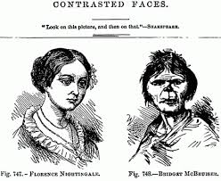
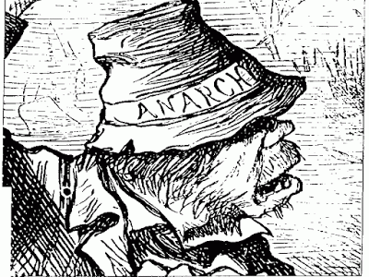
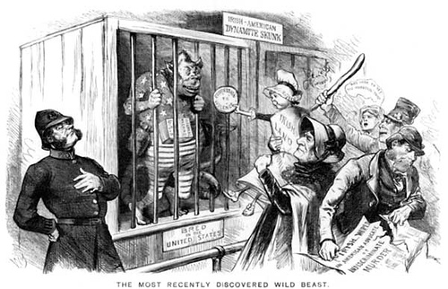
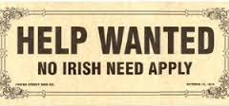
New vs. Old Immigrant Groups

Slide 7
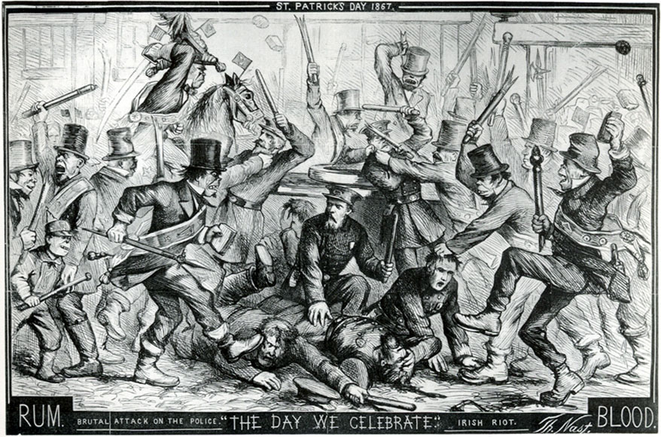

Slide 8
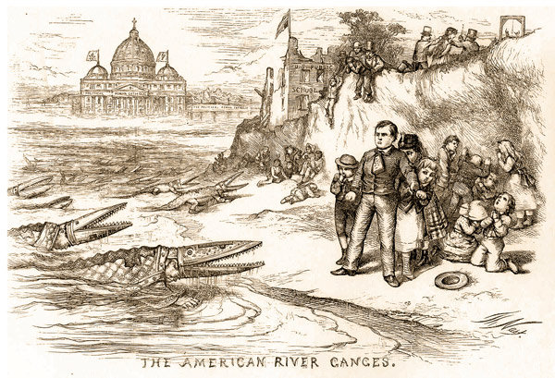
Anti-Catholic Political Cartoon

Slide 9
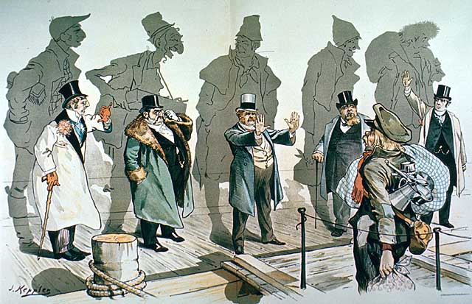
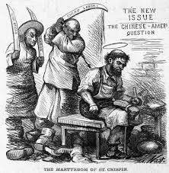

Slide 10
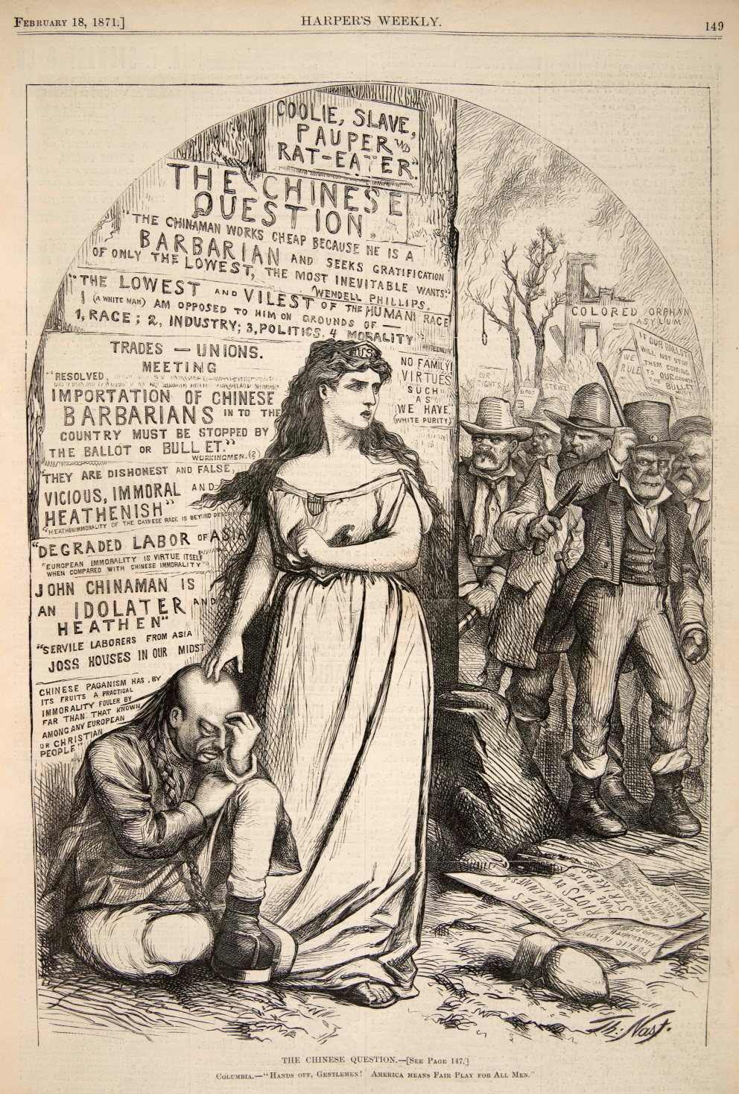
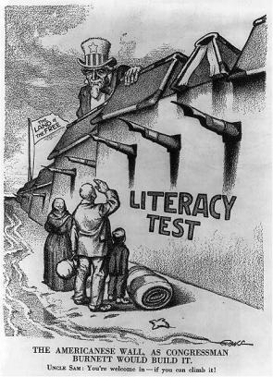

Slide 11
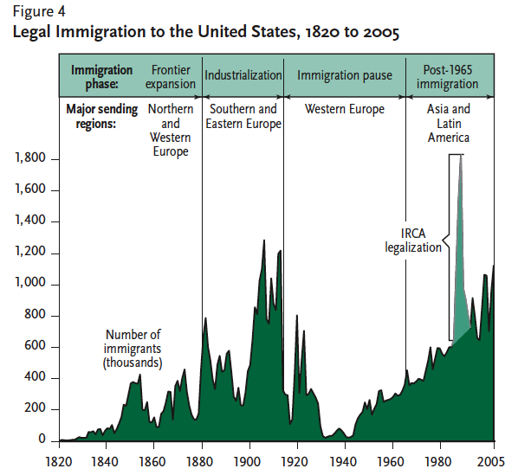
I. New Immigrants come to America
When? Who?
Two ‘Phases’ of Immigration
  1. Irish/ German
  2. Southern/Western Europeans (often Polish & Italian)
Often unskilled, poor, Catholic or Jewish (big generalization… but remember the push factors)
Majority Settled in Cities & contributed further to Urbanization

Slide 12
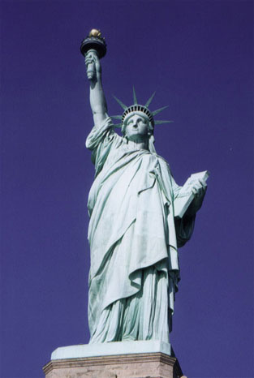

II. Why do Immigrants decide to leave home?
Push and Pull Factors
Pull Factors
Push Factors

Slide 13
II. Why do Immigrants decide to leave home?
Push and Pull Factors
Pull Factors
  Job opportunities
  Inexpensive land
  Family reunification
  better living conditions
  Political and/or religious freedom
  Education
Push Factors
  Lack of job opportunities
  Low standard of living
    Famine, poverty, and war
  Lack of religious freedom
  Lack of educational opportunities
  Poor medical care
  Natural disasters

Slide 14
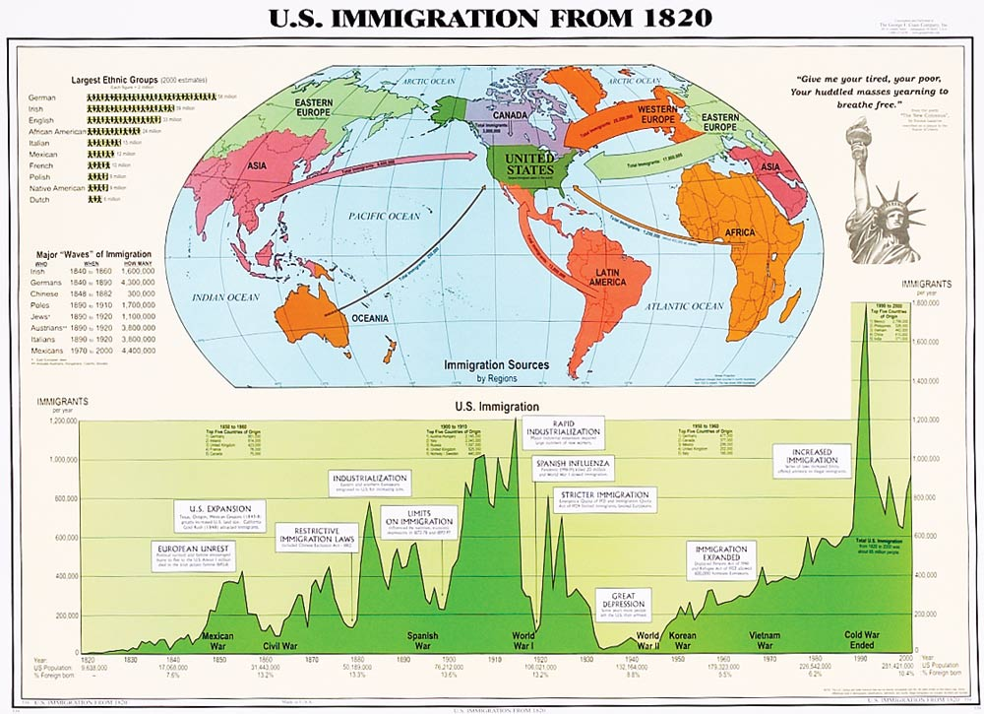

Slide 15
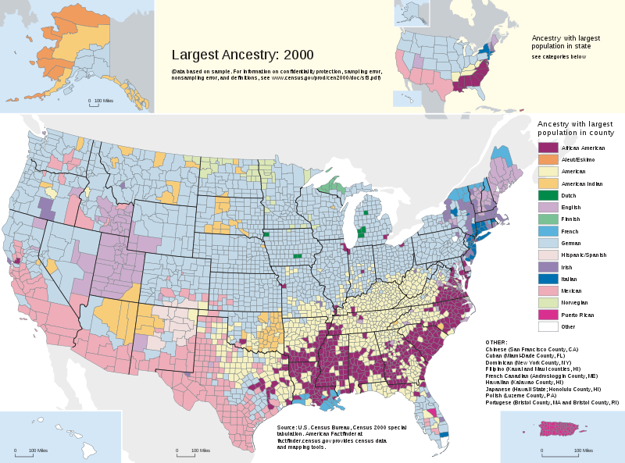
Historical Migration
Immigrant Explorer Activity
Task: Analyze the Interactive Immigration Map to determine Who is coming to the US and Where they are settling.

Slide 16
Immigration to the United States
Three Phases of Immigration to the United States
  First Wave – Colonial Period 1600s – 1700s
    English/ Scots Irish Immigrants
      Family immigration first in New England (largest population growth during colonial period)
  Second Wave – 1840s – 1920s
    1840s – 1870s = Irish & German Immigrants (Northern European)
      Irish = Potato Famine and ‘the Troubles’ continue to create push factors
    1870s – 1920s = Italian & Polish immigrants (Southern and Eastern European)
      Often chain migration (one family member makes enough $ to send of other family members) or Temporary Migration (return to home country after a few years) – depends on push factors
  Third Wave – 1965 (Immigration Leg.) – Present
    Current Immigration primarily from Asian, Latin America (Mexico)
    Often Circle Migration

Slide 17
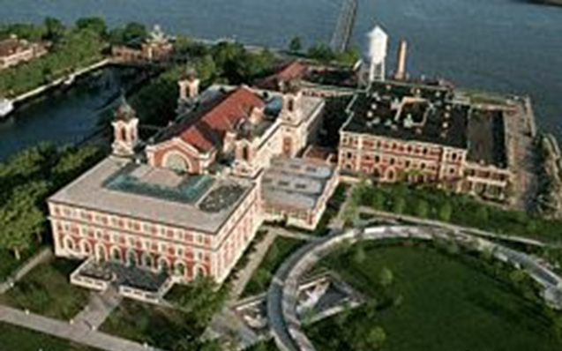
Arriving in America
Interpreting Information
Describe the process immigrants went through on Ellis Island.
Ellis Island Arrival Process
Steamship to Ferry
Medical Inspection
Legal Inspection
Proceed to New York
http://www.history.com/topics/ellis-island/videos/arrival-at-ellis-island
1.
2.
3.
http://www.history.com/topics/ellis-island/videos/the-ellis-island-medical-inspection?m=528e394da93ae&s=undefined&f=1&free=false
http://www.history.com/topics/ellis-island/videos/hurdles-to-citizenship-on-ellis-island?m=528e394da93ae&s=undefined&f=1&free=false

Slide 18
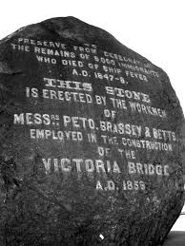
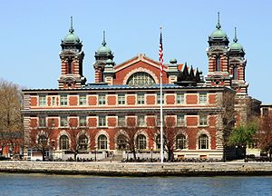
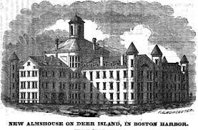
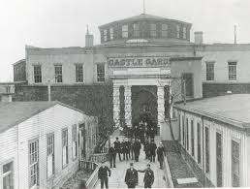
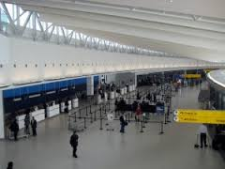
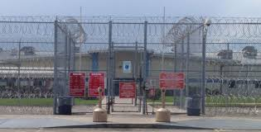
Immigration Centers Prior to 1890
Immigration Centers 1892– 1954
Canada – Goose Island
Ellis Island - NYC
Deer Island - Boston
Immigration Centers 1965 – Present
Southwest Immigration Detention Centers
LAX Airport – Los Angeles
Castle Garden - New York

Slide 19
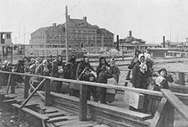
Citizenship in The United States
Naturalization Act of 1790
  1st Law regulating the granting of national citizenship
  Limited naturalization to ‘free white persons,’ required 2 yrs of residence, your father had to be a citizen
14th Amendment (1868)
  Granted citizenship to people born in the US regardless of race, or place of birth. (not extended to American born children of Chinese parents till 1898 – court case)

Slide 20
Immigration Regulation
Chinese Exclusion Act (1882 - 1943)
  Stopped the immigration from Asia
Immigration Act of 1924
  Put quotas on how many immigrants were permitted based on country of origin (skewed towards Northern Europeans)
Immigration and Nationality Act of 1952
  Abolished racial restrictions but retained a quota system for nationalities and regions (preference system based on ethnic group and labor qualifications)
Immigration and Nationality Act of 1965
  Abolished the national-origin quotas system
Immigration Act of 1990 (signed by George Bush)
  Increased legal immigration to the US by 40%
  Increased enforcement of Immigration laws post 9/11

Slide 21
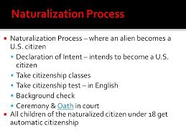
U.S. Immigration Policies
1980, Refugee Act - quotas do not apply to those seeking political asylum
1986, Immigration Reform and Control Act admitted large numbers of former illegals.
1990, Immigration Act raised global quotas to roughly 675,000
1995, visas issued Preferentially:
  480,000 - to relatives of people here
      140,000 - to those with special skills and education
      55,000 - to diversity candidates (i.e., mostly not from Latin Amer. or Asia)
      Current Total: 675,000
http://www.kcra.com/news/could-you-pass-the-us-citizenship-test/24414658

Slide 22
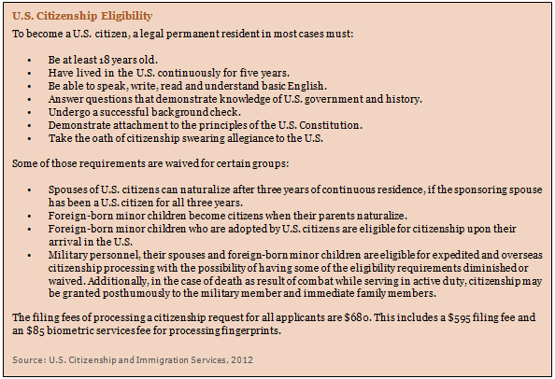

Slide 23
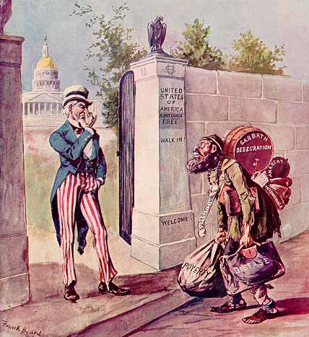
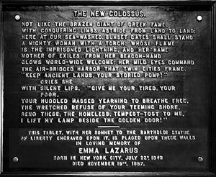
The US allows more than 1 million immigrants to become Legal Permanent Residents every year
  *Based on number of Permanent resident visas issued.

Slide 24
The Immigrant Experience Jigsaw
Jigsaw Instructions
Warm up Task: Summarize the instructions for the jigsaw in your own words and have your main group representative bring me your summaries and any questions your group might have.
Each of you have been put into “main groups” for phase 1 of this activity with one individual assigned the task of group representative. You will also have a “Color group” for Phase 2 of this activity based on the color on your document sheets.
Your main group will be given a document to analyze. You will become the Expert on this document by answering the document questions and present this information to your color group.
Your color group will create an organizer that includes information on a number of diverse aspects of the immigrant experience during the 19th century based on the 4 different document sources from each main group.
Once your color group has completed the organizer for the documents your color group representative will get 4 photos on living and working conditions for you to analyze as a group.
Your color group should then have a brief discussion on what supporting details you have found that could help you answer the question: Was 19th century American a land of opportunity for immigrants?
Exit Slip: At the end of the lesson you will reflect on what you learned during the lesson and your impression of the lesson itself.
*the information that you collect today will be used to complete an argumentative essay. Your groups should focus on finding supporting detail that would be useful in an argumentative essay.

Slide 25
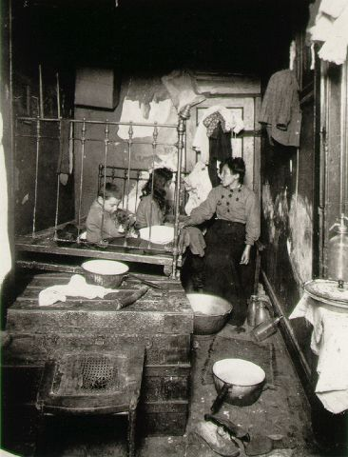
Was 19th-century America a land of opportunity for immigrants?

Slide 26
Positive Experiences | Negative Experiences
Doc 1 – Letter’s Home Positive – Evidence of Economic Success Positive – Evidence of Positive Experiences in American Society | Doc 3 – Two views on the Nativist Perspective Negative - Evidence of Economic Failure Negative – Evidence of Negative Experiences In American Society
Doc 2 – Oral History of Frank Klosowski Positive – Evidence of Economic Success Positive –Evidence of Positive Experiences in American Society | Doc 4 – Two view on the impact of Immigration Negative - Evidence of Economic Failure Negative – Evidence of Negative Experiences In American Society

Slide 27
Photographic Analysis of Living and Working Conditions
Living Conditions | Working Conditions
Photo 1 – Italian Immigrant Family 1897 What observations can you make about the living conditions in this photo? | Photo 2 – Coal Miners in 1920 What observation can you make about working conditions in this photo?
Photo 3 - Slumdwellers salute What observations can you make about educational opportunities and the purpose of education in the United States at this time? | Photo 4/ 5 – Pictures of Immigrant Businesses What economic opportunities did America offer to immigrants that their home countries did not?

Slide 28
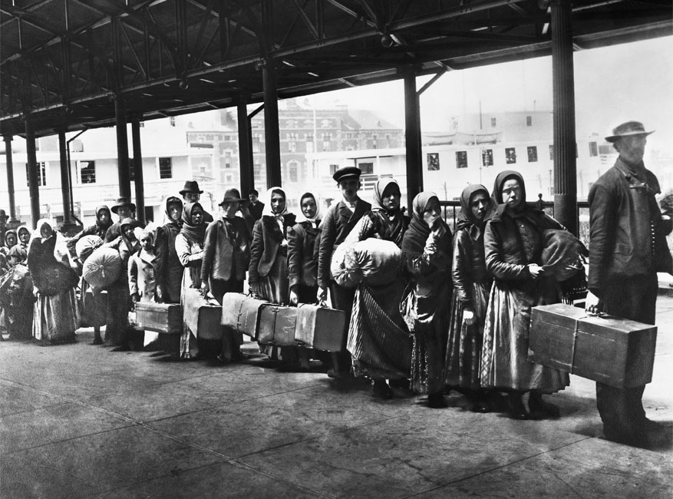
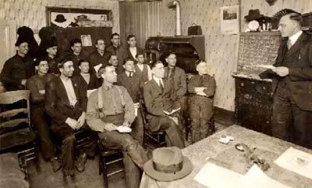
How do Immigrants Change America?
Fuel Industrial Growth
  Labor supply for factories
Encourage rapid urbanization (especially in Northeast & Midwest)
Made their traditions a part of American Culture
  Multiple Theories on the impact of immigration on US Culture
  Process known as Cultural Assimilation
    How do Immigrants become American?

Slide 29
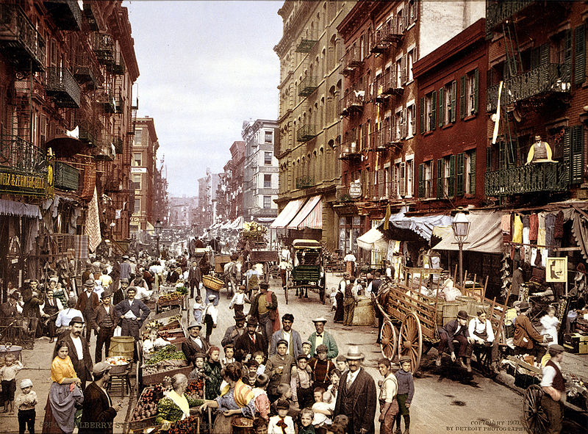
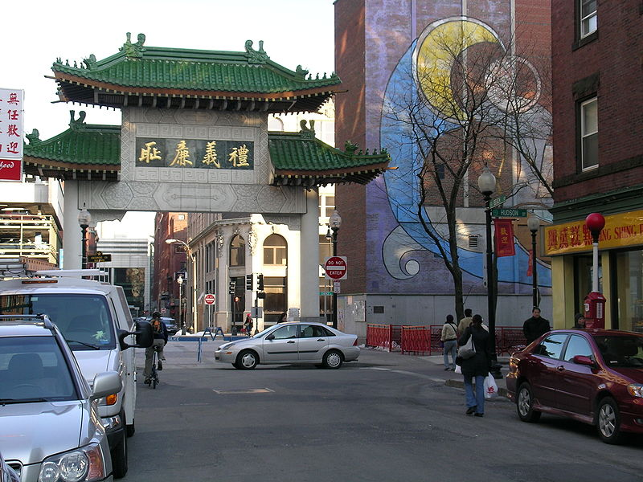
Case Study: The Immigrant Experience
The US is a land of immigrants, but what does that mean?
  Melting pot
  Salad bowl
  Or something else?

Slide 30
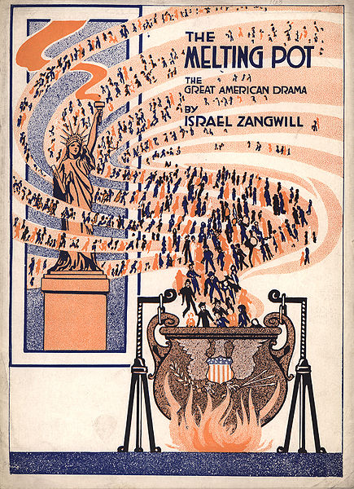
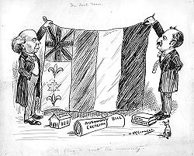
Different Theories on the Impact of Immigrants on US Culture
Melting Pot Model/ Classic Assimilation
Salad Bowl/ Cultural Pluralism
a metaphor for a heterogeneous society becoming more homogeneous (into a harmonious whole with a common culture)
1970 multiculturalism model
Metaphor for different cultures mixing, but remain distinct.

Slide 31
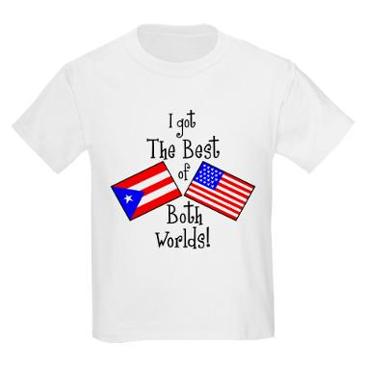

‘Child’s Plate/ Multiple Consciousness Model
Proposes that immigrants need not completely abandon their culture and traditions in order to reach the goal that the melting pot theory seeks
  a common culture/ with immigrants considering themselves citizens of their new nations first

Slide 32
Paragraph Structure
Topic Sentence (argument & reference your position)
    Structure Example for using Supporting details in a sentence:
  Tag quote, “piece of evidence that supports your statement. This can be a direct or indirect quote or a description of a visual source, but it must relate to the statement that you have made,” (Abbreviated Citation). Explanation on the significance of the evidence and how it related back to your argument.
Conclusion

Slide 33
Theories on Immigrant Assimilation
How Do Immigrants Become American?
The ‘Melting Pot’ Model |  | The ‘Salad Bowl’ Model |  | The ‘Multiple Consiousness’ Model
Summarize: |  | Summarize: |  | Summarize:
Strengths | Weaknesses | Strengths | Weaknesses | Strengths | Weaknesses

Slide 34
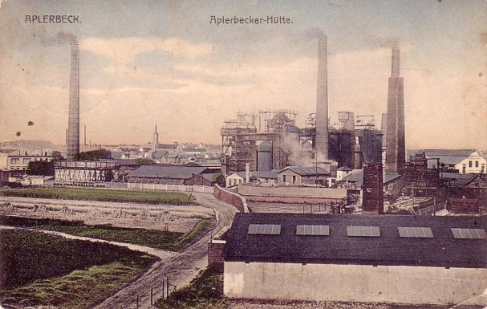
Review from WH2
What were the benefits and drawbacks of Industrialization in England?
Industrialization
The time period in which America changes socially and economy from an agrarian society into an industrial one.
Industrial Model = production of a good broken down into separate tasks in a factory which, with the use of technology, creates Mass Production.
Benefits
Drawbacks

Slide 35
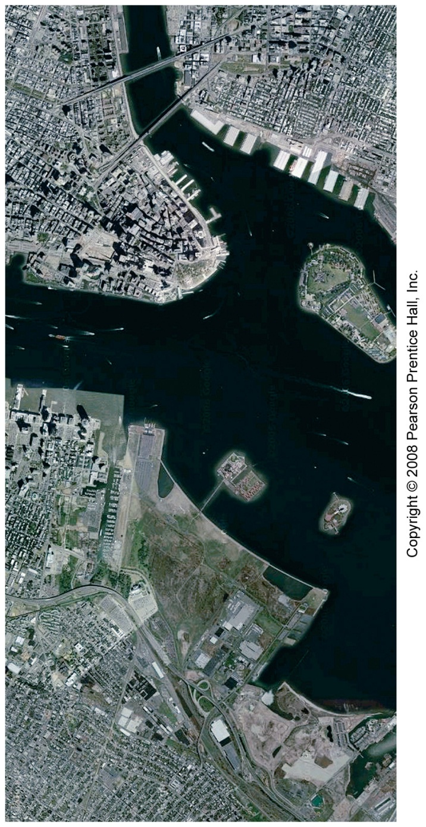
America the Story of US
The Creation of Cities
Fast Fact
  The largest internal migration in US history was the rural to urban migration that occurred in the late 1870s – 1920s
What elements were necessary for the creation of the Modern US city?
1.
2.
3.
4.
Immigration + Industrialization created a unique urban landscape

Slide 36
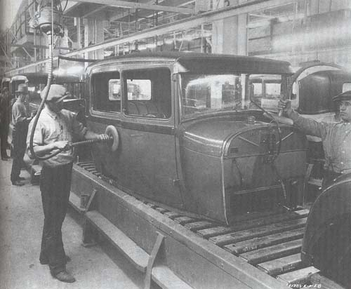
Industrialization
Causes
Effects
Factories, railroads, and mines created new jobs and drew foreign investors
American made goods became cheaper than imported goods (dominate the world market)
Businesses operated with little gov’t regulation (low wages, dangerous conditions, Environmental damage, etc…)
Mass production of goods
The Civil War
Vast amount of natural resources
Entrepreneurs
Large number of immigrants
Protective Tariffs
Laissez-Faire Economics
New inventions
Expanding railroad systems

Slide 37
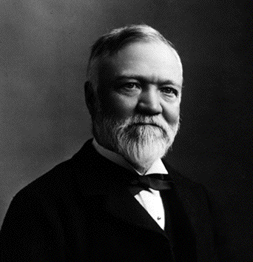
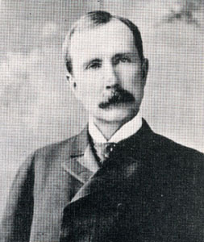
The Rise of Large Corporations
Rise of Corporations
Monopolies
Cartels
Horizontal Integration
Trusts
Vertical Integration
Debates over Big Business
Small Businesses bought up or squeezed out by competition
Consumers paid high prices
Providing Jobs
Business leaders as philanthropists
Andrew Carnegie: U.S. Steel (1870s)
John D. Rockefeller: Standard Oil (1880s)

Slide 38
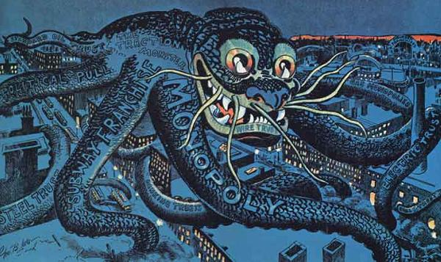

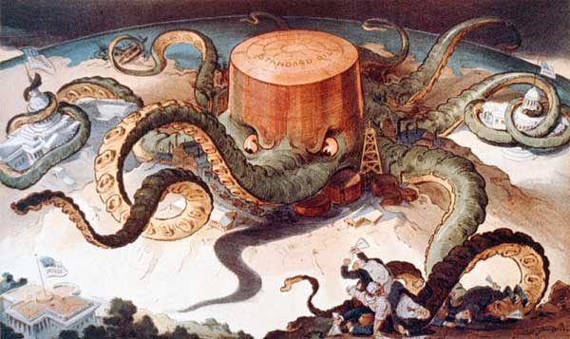
A company controls an entire industry or area of the economy
Because of its size and power, the company can destroy any competition
Lack of competition means company can charge what they want for the product
Review from WH2

Slide 39
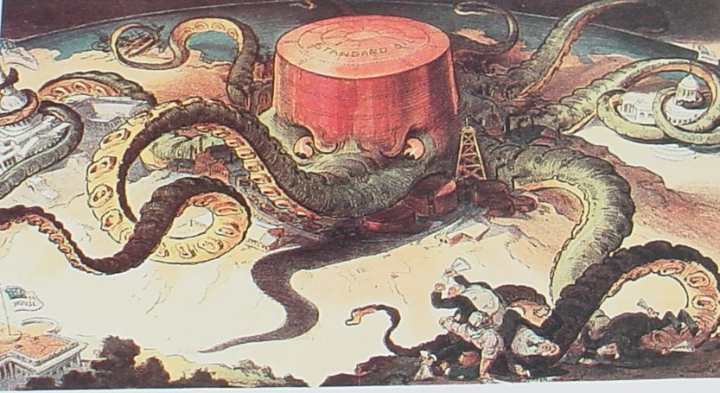
Monopolies
Standard Oil, 1906

Slide 40
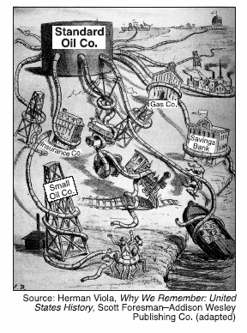
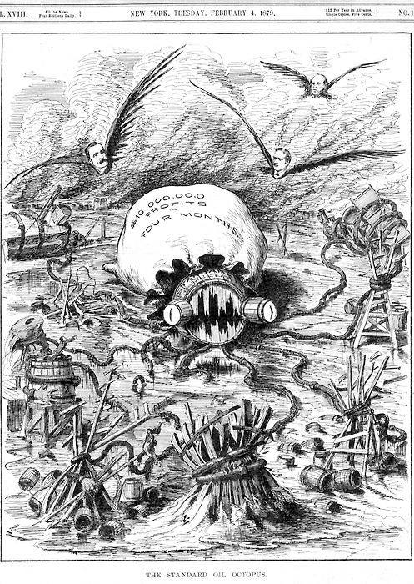
Standard Oil
http://www.pbs.org/wgbh/amex/rockefellers/sfeature/sf_1.html

Slide 41
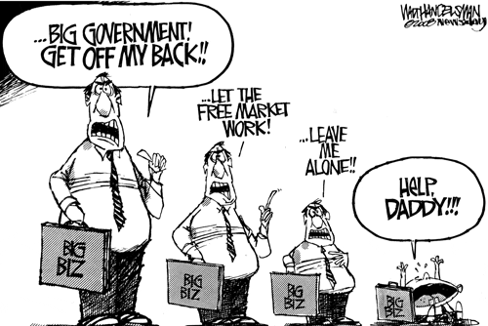
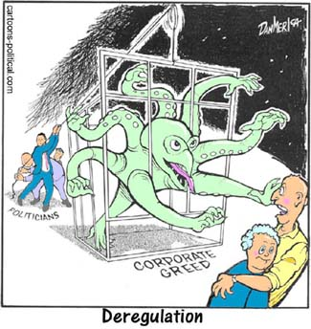
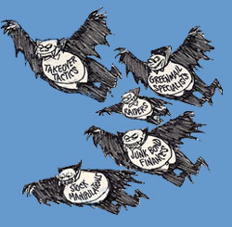
How is big business portrayed today?
How are these cartoons similar or different from the late 1800s cartoon?

Slide 42

Brainstorm
Laissez-faire vs. Regulation
Should government become involved in business?
Pros of Governmental involvement | Cons of Government Involvement
News: Septempber: 2011 - The U.S. Department of Justice filed an antitrust lawsuit against AT&T on Wednesday seeking to block its $39 billion merger with T-Mobile. The merger would create the largest wireless company in the United States, combining AT&T's 98 million customers with T-Mobile's 34 million users, for a total of 130 million subscribers. AT&T is currently the second-largest wireless company by number of subscribers, and T-Mobile is fourth. The DOJ said the merger would lead to a situation in which just two companies -- the AT&T-T-Mobile combination and Verizon Wireless -- would dominate the mobile market. The new AT&T and Verizon would account for more than two-thirds of wireless subscribers and 78% of the wireless industry's revenues.

Slide 43

Working During the Industrial Age
How did Industrialization and new technology affect the economy and society?
Activities – Analyzing Visual Sources
Read Summary of Labor Conditions and Create a list of ways to improve Labor Conditions
Observe Labor Conditions through Photo Analysis
Demands of the Labor Movement

Slide 44
Why should we learn how to Analyze Photographs as Primary Sources?

Slide 45

Practice Photo Analysis
Step 1: Observation
Step 2: In Depth Analysis
Step 3: Put Yourself in the Picture

Slide 46
Practice Photo Analysis
Step 1: Observation
Step 2: In Depth Analysis
Step 3: Put Yourself in the Picture

Slide 47
How does an In-depth Analysis Help you see additional detail in visual sources?
What are working conditions like in a Factory?

Slide 48
Labor Condition and Demands
Observed Labor Conditions
How Improve Labor Conditions
Labor Conditions:
Suggestions:

Slide 49
Gradual Government Regulation
Railroad industry controls economy
Midwestern states pass laws regulating freight rates
Supreme Court strikes down state laws
Senate creates the interstate Commerce Commission
Senate passes the Sherman Antitrust Act

Slide 50

Characterization of American Industrialization
Urbanization (Growth of Cities)
  City offers work, education & entertainment opportunities
  Slum Conditions = crowding, crime & sickness
Growth of Big Business
  New Business tactics
  Profits for the rich
  low wages for the laborers
Large Scale Immigration
  Opportunities in America
  Poor living & working conditions

Slide 51
Robber Barons or Captains of Industry
Did Business leaders help or hinder the US economy during the American Industrial Revolution?
Task:
Pick a Position –
Create 3 strong arguments supporting or opposing the question above.
Think of 2 pieces of supporting evidence (1 each for 2 of the arguments)
Andrew Carnegie: U.S. Steel (1870s)
John D. Rockefeller: Standard Oil (1880s)

Slide 52
Responses to Industrialization and Unrestrained Capitalism
The Labor Movement Grows
Labor Unions Organize
- National Trade Union
- Knights of Labor
- AFL
Workers Suffer
- Long Hours
- Sweatshops
- Dangerous Conditions
Strikes Break Out
- Haymarket Riot
- Homestead Strike
Pullman Strike

Slide 53
Major Strikes of the Late 1800s
Strike | Causes | Effect
Railroad Strikes 1877 | Response to cuts in workers’ wages | Set the scene for violent strikes to come
Haymarket square, 1886 | Part of a campaign to achieve an eight-hour workday | Americans became wary of labor unions, the Knights of Labor were blamed for the riot and membership declined
Homestead Strike, 1892 | Economic depression led to cuts in steelworkers’ wages | After losing the standoff, steelworkers unions lost power throughout the country
Pullman Strike, 1893 | Wages cut without a decrease in the cost of living in he company town | Employers used the courts to limit the influence of unions

Slide 54

Pullman Strike

Slide 55


Responses to Industrialization
Industrialization caused skilled craftsmen to shift to factory workers
Consequences =
  Loss of bargaining power as more work became unskilled
  Increased competition for jobs
  Impersonality of employer-employee relations
Unions form in response to the negative aspects of Industrialization (long hrs., poor conditions…)

Slide 56

Aims and Tactics of Management & Labor
Labor
organizations
BOTH want to see a prosperous America
Management
Goal - Profit Motive - Seek the greatest profit possible by increasing production through the most efficient use of materials and labor.
Late 1800s attempts to stop the organization of labor unions
  Yellow dog contracts (worker agrees to not join a union)
  Blacklists (list circulated by employers of workers involved in the unions
  Injunctions (order issued by the court to stop unions from doing something)
  The Open Shop (a place where only non-union members may work)
  Company police or spies
  Strikebreakers (called scabs by workers)
Goal – unions organize to improve workers status/ conditions. 3 big goals =
  Higher wages, shorter hrs. safe & sanitary conditions
Secondary Goals
  Abolition of child labor, recognizing collective bargaining, laws for workmen’s compensation
Tactics
  The strike (refusing to work as a form of protest)
  Picketing (demonstration in front of a business)
  The boycott (refusing to buy products from that company)
  The closed shop (a place where employer agrees to only employ union members

Slide 57
The Organized Labor Movement
 | Lowell Mill Girls 1836 | Knights of Labor 1869 | American Federation of Labor 1886 | Industrial Workers of the World 1905
Principles (why was the group founded) underlying problems
Goals (what they want to accomplish)
Tactics (how they want to accomplish these goals)

Slide 58
Discuss as a group – Was the labor movement from 1870-1920 successful?
How was the labor movement successful?
How was the labor movement NOT successful?

Slide 59


Effects of Industrialism
Negative and Positive Effects…

Slide 60


Class Differences
In the American The Gilded Age
The Wealthy - “Barons of Industry”
The poor working class
Observations:
What do the Newport ‘cottages’ look like?
Why are the entrepreneur building these
Homes?
Why was Mablehouse designed to mimic European palaces?
- Whitmoor 1-12, mablehouse 1 – 9:30
Observations:
What did the common tenement look like?
How did Jacob Riis raise awareness of these conditions?

Slide 61


The Progressive Era
What areas did the Progressives think were in need of the greatest reform?

Slide 62


Progressives
Problems
Muckrakers
Reforms
Industrial Hazards
Corrupt Government
No Women’s Suffrage
Poor living Conditions
Poor working Conditions
Monopolies
Gap between rich and Poor grows
Exposed Conditions
Exposed Political Corruption
Exposed Abuses by Big Business
Called for better schools
Factory Laws
Labor Law
Settlement Houses
Improved Education
Child Labor Laws
New Forms of local government
Utilities became public
Direct Primary
Initiative
Referendum
Recall

Slide 63



Slide 64
Women make Progress
How did women of the progressive era make progress and win the right to vote?
Women Found Reforms
  Hardships for women
    Difficult/Dangerous jobs outside of the home
    Easily abused by employers
  Reformers pushed for rights
    Women fought for shorter workday
    Florence Kelly and NCL fought for product labeling and safe workplaces
  Working for reform at home
    Temperance movement opposed drinking alcohol
    Margaret Sanger taught about birth control
    Ida B. Wells tried to help African American families

Slide 65

Women fight for the Right …. To Vote
Carrie Chapman Catt led movement
  Spoke out for NAWSA
    National American Woman Suffrage Association (NAWSA)
  Suffragettes helped get value in several states
Activists push for change
  Alice Paul formed National Women’s Party (NWP)
  Protest marches and hunger strikes
The 19th Amendment
  Reformers supported World War 1
  Congress approved amendment-ratified in 1920
http://www.youtube.com/watch?v=Be9w6WjubkU
http://www.youtube.com/watch?v=AtUY-wVLdeY
http://www.youtube.com/watch?v=G811_Ej7LiQ

Slide 66



Slide 67



On the eve of the inauguration of President Woodrow Wilson (1856-1924) in 1913, protesters thronged a massive suffrage parade in the nation’s capital, and hundreds of women were injured.

Slide 68





19th Amendment:
“the rights of citizens of the United States to vote shall not be denied or abridged by the United States or by any State on account of sex”
On August 18, 1920, Tennessee became the 36th state to ratify the amendment, giving it the two-thirds majority of state ratification necessary to make it the law of the land. Eight days later, the 19th Amendment took effect.

Slide 69

Struggle against Discrimination
Progressivism Contradicts itself
Settlement houses and other civic groups aid in Americanization of immigrants
BUT
Immigrants use of alcohol alarms temperance supporters (turns to targeting immigrants)
Eugenics: So-called ‘scientific’ theories claiming that dark skinned people were less intelligent than whites results in racism
Plessy v. Ferguson ruling by the Supreme Court supports segregation in use of public services

Slide 70

How was the Progressive Era a contradiction at times?
Progressives wanted to improve society but they often excluded groups, (such as immigrants, African Americans, etc.) from the progress made during this era.

Slide 71


Continued Discriminations
Native American land is sold
  Treaties routinely broken and Bureau of Indian Affairs routinely takes away their rights to self gov’t
  movement begins to immersed Native Amer. Children in European-Amer. Culture
    Forced to ‘civilize’
Asian Americans encounter prejudicial laws/ exclusion acts that bar additional Asian immigration

Slide 72


Discrimination and Racism is Institutionalized
Types of Segregation
De jure segregation is separation enforced by law
De facto segregation occurs when widespread individual preferences, sometimes backed up with private pressure, lead to separation.

Slide 73

The Struggle Against Discrimination
Demands for Reform
Niagara Movement demands constitutional rights for African Americans =
  NAACP forms
Urban league helps poor urban black workers
Anti-defamation League forms to help Jewish Americans, but expands operation to all minorities
Mexican Americans form mutualistas (community based mutual aid societies)

Slide 74
Progressive Era Webquest
Step 1 and 2
Step 3
Answer the overview questions on the Progressive era
Research and answer questions on your assigned progressive era (women, African-Amers., muckrakers, temperance)
As a group (by numbers) – meet, discuss and complete the chart. Then answer the 2 concluding questions
  Of the many reform movement occurring during the Progressive Era, which reform movement had the most positive, lasting impact on society?
  What evidence can you use to support your opinion?

Slide 75
Which of these reform movements had the most positive, lasting impact on society to this day?
Women’s Rights Goals: Achievements: | Muckraking Goals: Achievements:
African American Goals: Achievements: | Prohibition Goals: Achievements:

Slide 76



Politicians… Roosevelt, Taft and Wilson
How well did Presidents Roosevelt, Taft, and Wilson promote progressive goals in national policies?
Presidential Powers all for:
Seeking Legislative Reforms
Used the “bully pulpit” to push for reform
  Using your position to speak out on an issue
    Bully = terrific
    Pulpit = platform
Goals of Progressivism
Protect social welfare
Promote moral improvement
Create economic reform
Foster efficiency

Slide 77

Assassination of President McKinley, Sept 6, 1901
How does Theodore Roosevelt become President?
Leading member of the reform faction of the Republican branch of New York politicians
Becomes famous as the leader of the Rough Riders in the Spanish American War
Governor of NY (makes political enemies)
Becomes Vice President under President McKinley
*Becomes the Champion of the Progressive Movement in politics
Roosevelt succeeded to the office at age 42, becoming the youngest United States President in history
Notes:
Description: Assassination of William McKinley. Czolgosz shoots President McKinley with a concealed revolver, at Pan-American Exposition reception, Sept. 6th, 1901.
Keywords:
Credit: Library of Congress
http://teachpol.tcnj.edu/amer_pol_hist/thumbnail261.html

Slide 78



Theodore Roosevelt: the “accidental President”
Republican (1901-1909)
(The New-York Historical Society)
Notes:
Wadsworth.com (portrait and on horseback); Underwood and Underwood. Theodore Roosevelt Addressing a Crowd, 1901-09. Collection of The New-York Historical Society.
PBS- American Photography

Slide 79

Theodore Roosevelt
Presidential Accomplishments
Settlement of 1902 coal strike favoring workers but did not recognize union
Filed 44 suits against businesses under Sherman Anti-Trust Act
Elkins and Hepburn acts strengthen ICC
Pushed passage of Meat Inspection and Pure Food and Drug Acts
Set aside lands for National parks, and preserves
Commerce and Labor Depts. Established
Created the Bull Moose Party to run against Taft

Slide 80
CONSERVATION:
National Parks and Forests
Notes:
Faragher, Out of Many, 3rd Ed.; http://wps.prenhall.com/hss_faragher_outofmany_ap/

Slide 81


Why is Teddy Roosevelt Awesome?
Very Aggressive Progressive President
  Ex: VERY Anti-trust, promoted Environmental Conservation, very sympathetic towards Labor Unions, supported the popular election of Federal and State judges (give more power to the electorate)
  championed his "Square Deal" domestic policies, promising the average citizen fairness, breaking of trusts, regulation of railroads, and pure food and drugs.

Slide 82


William Howard Taft
President 1909-13
Republican
Postcard with Taft cartoon
Notes:
This postcard depicts how President Theodore Roosevelt, in command of the Republican Party, persuaded his friend William Howard Taft to run for president in 1908. Taft was not eager for that office, but Roosevelt succeeded in convincing him to seek it. With Roosevelt's strong support, Taft was elected, but he proved a disappointment to Roosevelt. (Collection of Janice L. and David J. Frent)

Slide 83

William H. Taft
“Busted” twice as many trusts as Roosevelt.
Payne-Aldrich Tariff which lowered overall rates*
Mann-Elkins Act strengthened the ICC placed telephone and telegraph under ICC
Standard Oil Co. was successfully prosecuted
16th Amendment ratified—income tax

Slide 84

Taft’s Progressive Accomplishments
trust-busting
forest and oil reserves
Sixteenth Amendment
BUT: Caused split in Republican Party
  Payne-Aldrich Tariff (1909)
  Pinchot-Ballinger Controversy
(Taft has) “…completely twisted around the policies I advocated and acted upon.”
-Theodore Roosevelt

Slide 85

Why is Taft Underrated?
He was efficient and oversaw the passage of many laws to limit the power of big business
BUT
More conservative than Roosevelt, favored business leaders over unions, wanted high tariffs to protect American products
Only US President to become Chief Justice of the Supreme court

Slide 86


Election of 1912
Woodrow Wilson
Woodrow Wilson
Theodore Roosevelt cartoon, March 1912
Notes:
Wilson: Wadsworth.com; Description: Theodore Roosevelt as an opera singer who wins the favor of "Miss Insurgency", while Robert La Follette watches in disgust. 03/18/1912. Artist, Berryman, Clifford K.;Credit: National Archives and Records Administration; http://teachpol.tcnj.edu/amer_pol_hist/thumbnail277.html

Slide 87

1912 Presidential Election
Notes:
wadsworth

Slide 88

Woodrow Wilson
Passage of Underwood Tariff—lowering rate
Federal Reserve Act—created a central banking system
Federal Trade Commission
Clayton Anti-trust Act
Child Labor Laws
17th,18th,and 19th amendments passed
  17th = election of senators by popular vote
  18th = prohibition
  19th = right to vote for women

Slide 89

Federal Reserve System
Federal Reserve Act
Notes:
Thomson Wadsworth.com

Slide 90

What makes Wilson Unique as a President?
Only President to have a PhD (in History!) and was President of Princeton University
LOTs of legislation is passed under his administration
BUT
He is the end of the Progressive Era Presidents

Slide 91
How well did Presidents Roosevelt, Taft, and Wilson promote progressive goals in national policies?
Roosevelt | Taft | Wilson
What significant legislation or organization was each President responsible for creating?
How did each President promote these progressive era goals? (how successful were they)
How did each President expand the role of the federal government while in office?

Slide 92
End Notes on the Progressive Era
How did the US change in the 1800s?
How Progressive was the Progressive Era?
What was accomplished?
What problems did the US still face by 1914?
Successes?
Failures?

Slide 93
Immigration, Industrialization, and Progressivism
Essential Questions:
Immigration
Why do Immigrants come to The United Stares and what impact did they have upon society?
What was life like for Immigrants in the US during the 19th century?
Industrialization
How did Industrialization and new technology affect the economy and society?
How did big business shape the American economy in the late 1800s and early 1900s?
Progressivism
How did Progressivism change politics and society in the 19th century?

Slide 94
ESSENTIAL QUESTION
How effective were Progressive Era reformers and the federal government in bringing about reform at the national level in the period 1900-1920?
Notes:
(2003B DBQ)

Slide 95
Progressive Era Webquest Recap…
The Women’s Rights Movement
Muckraking: Exposing the Ills of Society
The Fight for Equality: American Americans and Civil Rights
Prohibition: The Temperance Movement

Slide 96
Phase 3: Debating, Discussing and Reaching Consensus
As a group, you should discuss and debate our essential question:
'Of the many reform movements occurring during the Progressive Era, which type of reform movement had the most positive, lasting impact on society to this day?'
and
'What evidence exists in today's society to support your opinion?'
On a separate sheet of paper and as a group you will write a short editorial that answers all of these questions:
Of the many reform movements occurring during the Progressive Era, which reform movement had the most positive, lasting impact on society to this day?
B. What evidence exists in today’s society to support your opinion?
C. Who were the key personalities related to this movement.

Slide 97
Progressivism
WHEN? “Progressive Reform Era”
1890s
1901
1917
1920s
WHO? “Progressives”
  urban middle-class: managers & professionals; women
WHY? Address the problems arising from:
  industrialization (big business, labor strife)
  urbanization (slums, political machines, corruption)
  immigration (ethnic diversity)
  inequality & social injustice (women & racism)

Slide 98
Robber Barons or Captains of Industry
Did Business leaders help or hinder the US economy during the American Industrial Revolution?
Write a Thesis that includes 3 strong arguments supporting or opposing the question above.
Andrew Carnegie: U.S. Steel (1870s)
John D. Rockefeller: Standard Oil (1880s)

Slide 99
Immigration Ellis Island
https://www.youtube.com/watch?v=u4wzVuXPznk

Slide 100
Warm Up Activity:
Creating Arguments
Arguments = expressing a point of view on a subject and supporting it with evidence
Strong Arguments should include a both a statement and supporting evidence
  Read UNC’s definition of a strong argument
  Use the information from chapter 13, and the Story of US video & think of 2 pieces of supporting evidence for each of the arguments that you created.
    Did Business leaders help or hinder the US economy during the American Industrial Revolution?
http://writingcenter.unc.edu/handouts/argument/

Slide 101
America the Story of US
The Creation of Cities
Fast Fact
  The largest internal migration in US history was the rural to urban migration that occurred in the late 1870s – 1920s
What elements were necessary for the creation of the Modern US city?
1.
2.
3.
4.
Immigration + Industrialization created a unique urban landscape

