Slide 1
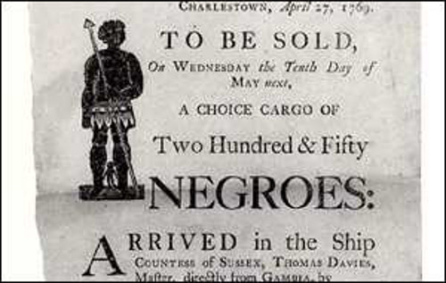
Slavery During the civil war
Juliette Sasso and Jasmine Griswold

Slide 2
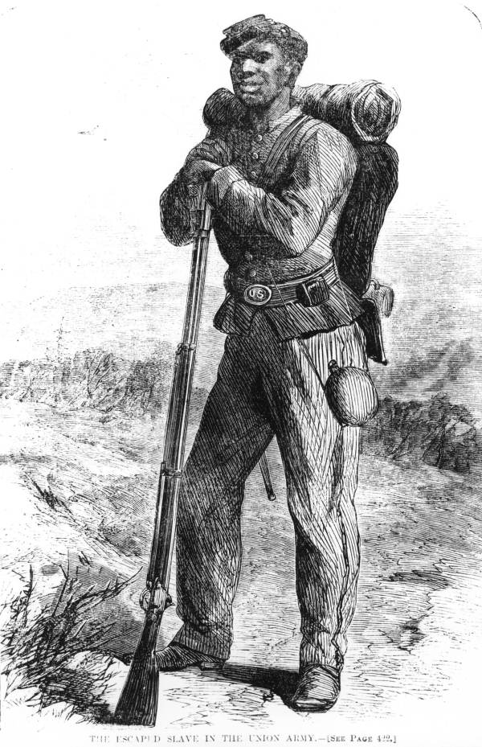
History of Civil War and Slavery
-The North not necessarily needing Slavery, but the South depending on it.
-Slaves lived in “Quartiers”, which were they’re home.
-treated as Property, not as people.
-Relating to today: Just from background knowledge, How does one think Slavery has impacted today’s society?

Slide 3
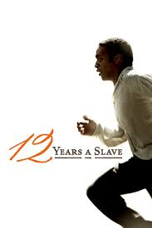
Clip: Twelve Years A Slave
-The movie “Twelve Years A Slave”, published by soloman northup, was released in 2013, showing The perspective of an Enslaved African American who had to endure the hardships of Slavery.
-https://www.youtube.com/watch?v=byaCy3qqffE
-Relating to today: Is this an accurate representation of slavery, comparing it to what is learned in history classes?

Slide 4
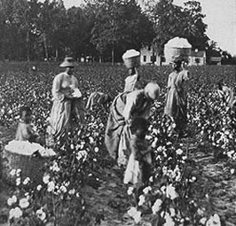
Purpose of Slavery
Cause: Effect:
-Greater demand for Goods -Greater Quantity
-South Depended on it -Boosted Economy
-To Fight, Help in Civil War -Greater Quantity
Relating to today: The North eventually needed more soldiers, therefore using African Americans, Would the union still have won the Civil War if African American’s did not help?

Slide 5
Clip: Difficulties After the Civil War
-Even after the Civil War had ended, and Slaves were technically “free”, they’re hardships did not end, because They now needed to find a way to Support themselves and their families in this world.
- https://www.youtube.com/watch?v=GnEKiw7LPvw
Relating to today: Does one think any jobs today are connected to African Americans joining them After the Civil War?

Slide 6
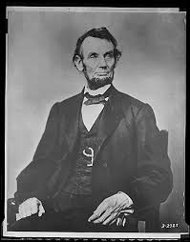
Impact
-Due to the increase of MAss production, American Advanced in Rapid Economic Growth, which would only increase.
-Which the Emancipation Proclamation, Laws were Finalized to end slavery, changing the COnstitution, Treating people fairly.
Relating to today: Overall, How are people treated fairly, and is there still inequality today?

Slide 7
Sources
-Slavery During The Civil War. Google Images, www.google.com search?rlz=1C1VFKB_enUS769US769&tbm=isch&q=slavery+during+the+civil+war&spell=1&s a=X&ved=0ahUKEwjnxuyO6bHXAhVIQSYKHfBSBasQvwUIOygA&biw=1366&bih=662&dpr=1. Accessed 9 Nov. 2017.
-"Blood and Glory: The Civil War in Color: African Americans After the War | History." Youtube, 27 Apr. 2015, www.youtube.com/watch?v=GnEKiw7LPvw.
-Martinez, Jaime Amanda. "Slavery during the Civil War." Encyclopedia Virginia 1
-Colin A. Palmer, Passageways: An Interpretive History of Black America, Vol.
-Slavery in America." Slavery in America, History Channel, www.history.com/
topics/black-history/slavery/pictures/slave-life/punishments-for-slaves.
Accessed 3 Nov. 2017.
-"Slavery in the American South." cry-usa.org, Constitutional Rights Foundation,
www.crf-usa.org/black-history-month/slavery-in-the-american-south. Accessed
31 Oct. 2017.
-"12 Years A Salve- Soap (HD) Chiwetel Ejiofor, Michael Fassbender." Youtube, 8
Nov. 2013, www.youtube.com/watch?v=byaCy3qqffE. Accessed 6 Nov. 2017.

