Slide 1
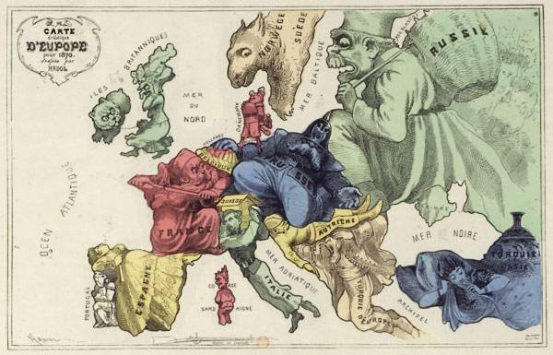
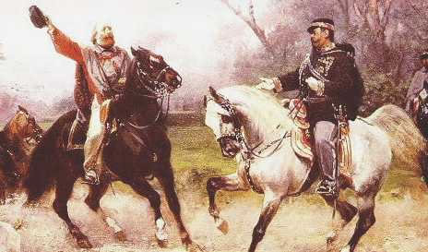
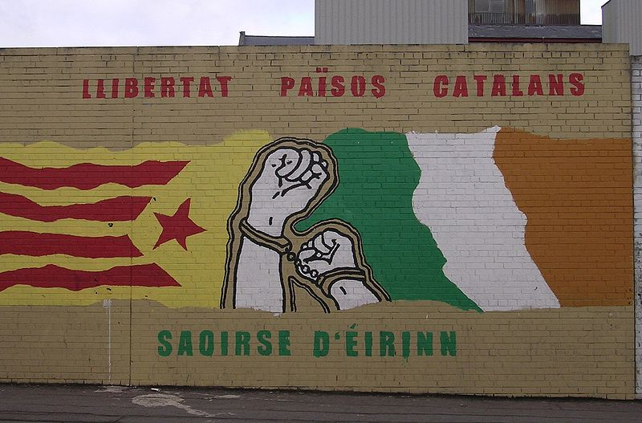
Nationalism
Changing Europe

Slide 2

Nationalism Defined…
Define nationalism
2. Define nation (what is a nation? How are nations made?)
3. What makes you an American? (List at least 5 things and explain how they make you an American.)

Slide 3
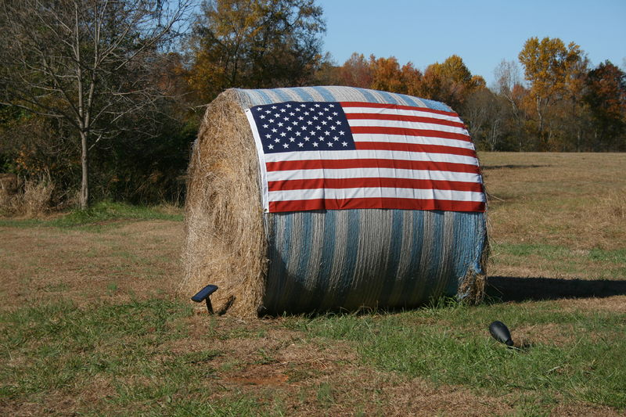
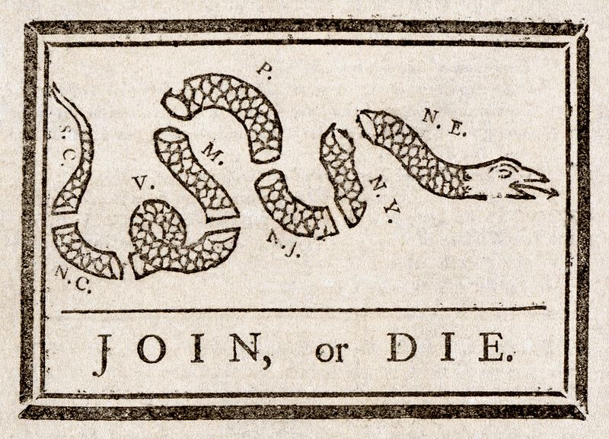
Nationalism
Define:
  A strong identification with a group (ex: I AM an American)
  Devotion and loyalty to one’s own nation; patriotism
  The desire for national advancement or independence
  The policy of asserting the interests of one’s own nation
Examples of Nationalism:
1.
2.
3.

Slide 4
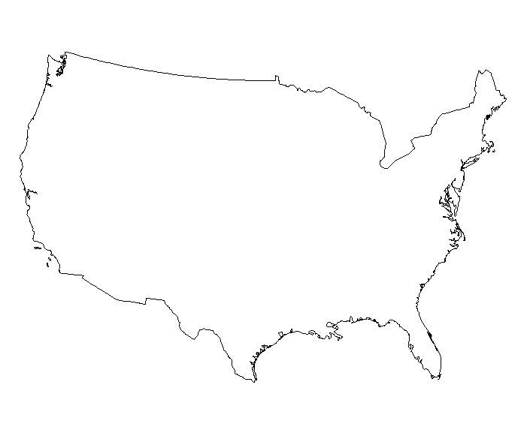
Nationalism
What makes a nation?
What makes us American?

Slide 5
Changing the Map of Europe
Focus on the maps on pages, 693, 703, 707, and 817.
Locate (create a key if you shade)
1815: Sardinia, Prussia, Austria, Ottoman Empire, and France.
1913: Greece, Germany, Italy, Ottoman Empire, France, and Serbia.
Trace/outline on the maps
On the map of Europe in 1815: boundaries of the German Confederation
On the map of Europe in 1913: the Balkan Peninsula
Look closely at the northeast corner of France. Did France gain or lose land in its northeast corner between 1815 and 1913?
Name one other country that lost land between 1815 and 1913.
Look closely at the southern border of Austria-Hungary. Did Austria-Hungary gain or lost land on its southern border between 1815 and 1913?
Name one other country that gained land between 1815 and 1913.
What major change took place in the Balkan Peninsula between 1815 and 1913?
What major change took place in central Europe between 1815 and 1913?

Slide 6
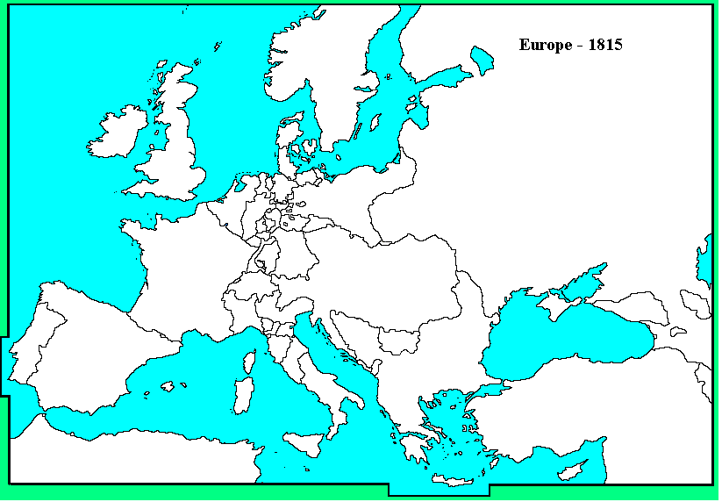

Slide 7
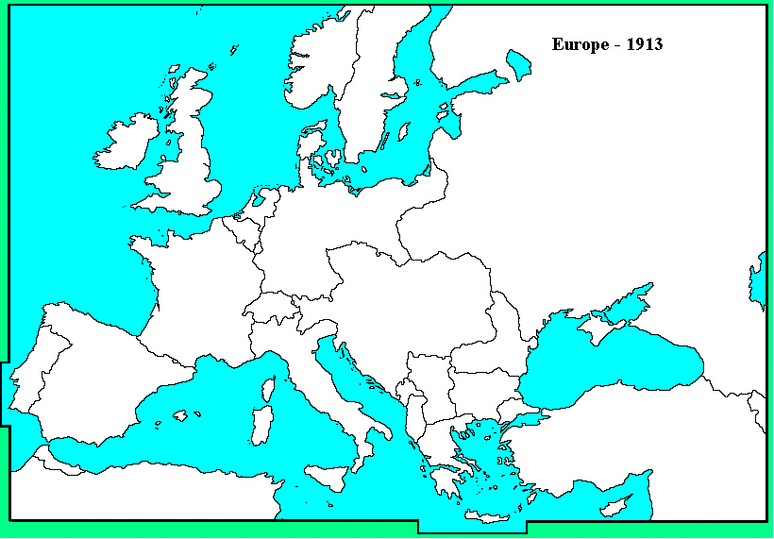

Slide 8
Discussion:
Final Map Questions
Pull together ideas
Many of the European boundaries changed dramatically from 1815 -1913. What are some ways that boundaries traditionally change? (list at least 3 and explain)
2. Using your definition for nationalism - How did nationalism inspire the major changes to boundaries in Europe between 1815 and 1913?

Slide 9
Birth of the German Empire
1
Napoleon raids German lands, he conquers and partially unifies the German states
2
As states gain freedom from French rule, the people demand a unified Germany.
3
Prussia creates an economic union called the Zollverein
4
Bismarck becomes chancellor (the highest official of a monarchy) and strengthens the Prussian army . Leads Prussia into 3 wars for power and to pave the way for German Unity
5
In 1866, Bismarck invents an excuse to attack Austria and start the Austro-Prussian War. Prussia wins and annexes several north German states
6
Bismarck provokes Franco-Prussian War of 1870 to create a unified German empire

Slide 10
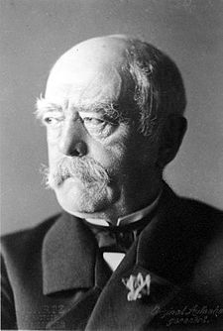
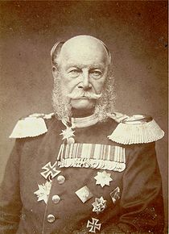
Birth of the German State
7
Otto von Bismarck unites German states under Prussian rule
8
William I takes title of kaiser (Emperor, derived from Caesar) and the Second Reich begins
9
Bismarck drafts constitution, creating a two-house legislature- the Bundesrat and the Reichstag
Otto von Bismarck – Chancellor 1862-1890, nicknamed the Iron Chancellor becoming the hero of nationalistic Germans. Dominated politics during his time as Chancellor
William I, German Emperor – King of Prussia who becomes the first German Empire after unification.

Slide 11
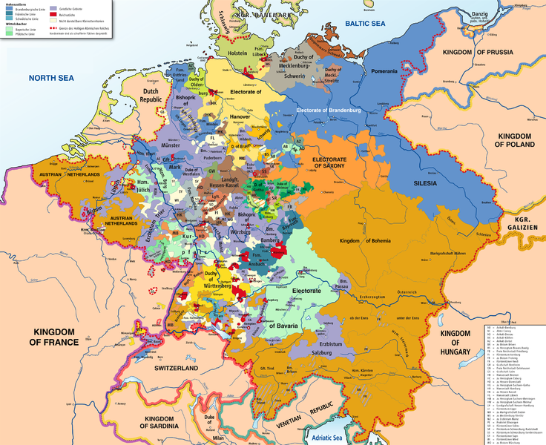

Review
Define: Nationalism:
What is the ‘German’ identity?
  How did the Germanic States unify into country?

Slide 12
Why unify Germany?
Nationalism Inspired by Napoleonic era
  Napoleon had unified much of Germany
  Germans shared desire to rid Germany of Napoleon
Shared history & culture
  Hanseatic League, *Holy Roman Empire
  Shared language: German
  Shared stories: ie: Brothers Grimm

Slide 13
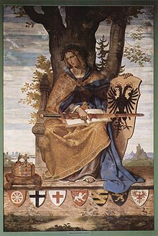
What is German…
The following excerpt is from the beginning of "What is German?" where Richard Wagner gives his account of how the German people became a national entity even without political borders to define it.
“An attempt to gain a clear idea of what is really to be understood by the expression "German" has often weighed upon my mind.… The word "deutsch" (German), according to the latest and most exhaustive researches, is not the name of a specific people; there was not in the past a race that could claim the original title "German." On the contrary, Jacob Grimm has proved "diutisk" or "deutsch" means nothing more than that which is familiar to those of us speaking a mutually intelligible language.… It is to the speech and the original homeland, then, that the idea of "deutsch" is knit; and there came a time when the people of this name could reap the reward for their loyalty to their homeland and their speech.”
(Richard Wagner, "What is German?" 1865)
Germania, a personification of the German nation.
She is holding a shield with the coat of arms of the German Confederation with the seven traditional Electors of the Holy Roman Empire.

Slide 14
Tactics in the Unification of Germany
Instructions:
Read your assigned source and answer the questions associated with your source
Compare your sources – what method(s) does your source promote and why?
Answer the group questions
Bismarck – Blood and Iron | Wilhelm – A Place in the Sun | The Zollverein

Slide 15

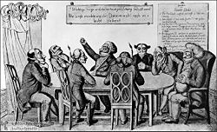
Who led unification?
Otto von Bismarck and Wilhelm of Prussia’s strategies
  Practical politicians – realpolitik
    refers to diplomacy based on power and on practical and material factors, rather than diplomacy based on ethnical choices
  Conservative: monarchy, limited suffrage
  Blood and Iron
  https://www.youtube.com/watch?v=mz9Cy0xUH0E

Slide 16
How was unification accomplished?
Diplomacy, Economy, & Wars
Diplomacy:
  Gained support from foreigners
    Teamed up with Russia against Poland
  Formed Alliances
    Alliance with Italy against Austria (France)
Economic unity in the Zollverein (Economic Union)
3 major wars unite the German Confederations
  Danish-German War (1864)
  Austro-Prussian War (1866)
  Franco-Prussian War (1870)

Slide 17
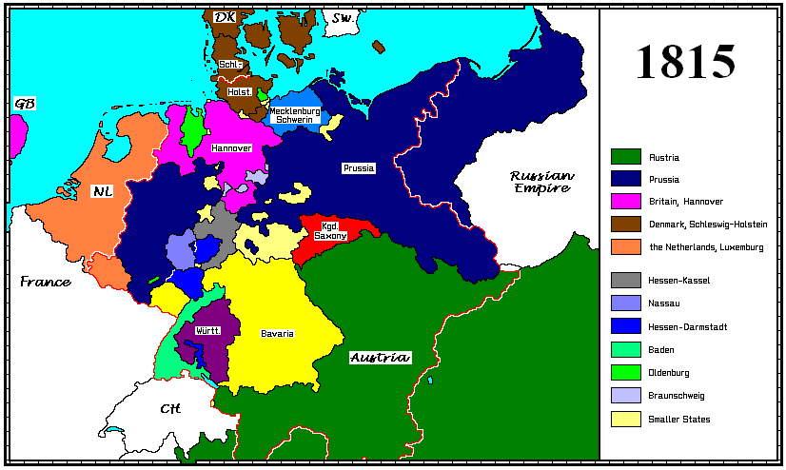
After Congress of Vienna (1815)

Slide 18
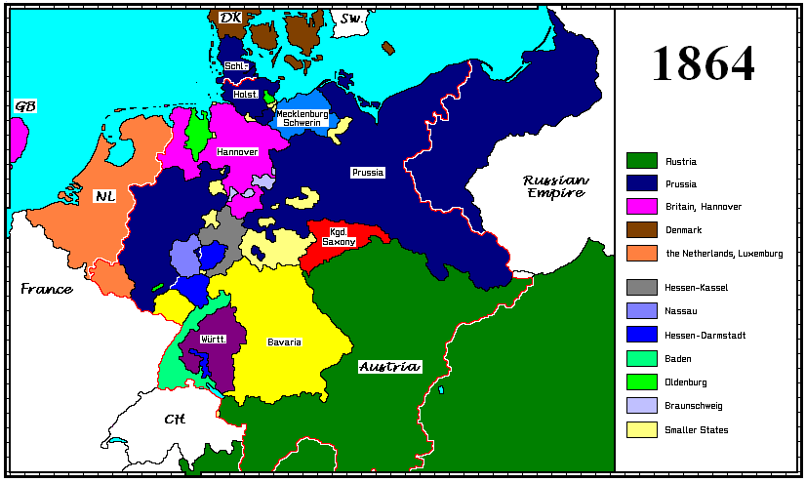
Danish-German War

Slide 19
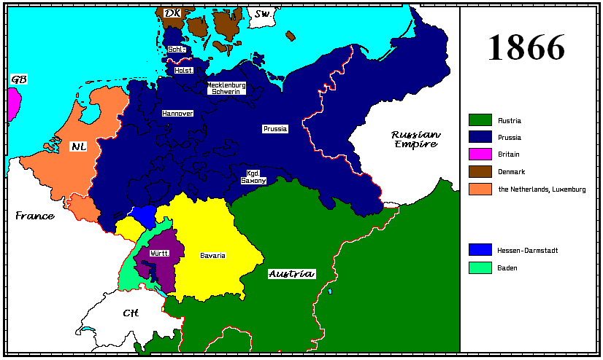
Austro-Prussian War

Slide 20
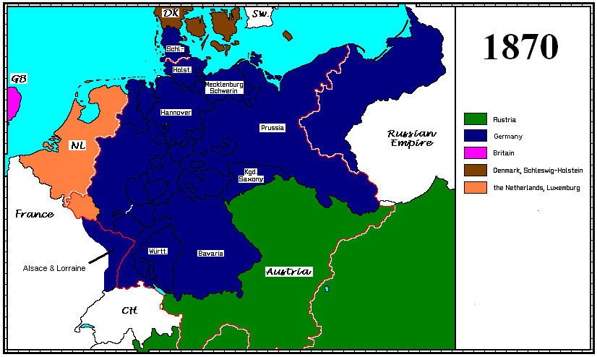
Franco-Prussian War

Slide 21
Cause and Effect of Creating a strong German State
Causes
1. Abundant natural Resources
2. Disciplined and educated workforce
3. Society that prided itself on its sense of responsibility
4. Rapidly growing population
5. Social welfare programs that supported workers
Strong German Nation
Effects
1. Industrial development
2. Scientific research and development
3. Economic development
4. Workers who realized conditions could improve without revolution

Slide 22
Italian and German Unification
 | Italy | Germany
Main leader(s) & philosophies
Figurehead - Kings of new Sts
Main foes or obstacles
Chronology of events & wars
outcomes

Slide 23
Main leader(s) & philosophies
Figurehead - Kings of new Sts
Main foes or Obstacles
Chronology of events & wars
Outcomes
Germany
* Otto von Bismark – Chancellor - supports the use of “Blood & Iron” to unify Germany and “Realpolitik” (power over principles) to gain more power for Germany
*William I - kaiser (or emperor) of the new German State
Foreign – Keep France weak, *Britain is the main naval power & later Germany’s main competition Domestic – The Catholic Church & Socialists (threats to unity & Socialists want democratic reforms)
Wars used to establish the empire: Annex more land 1. Danish-German War 2. Austro-Prussian War 3. Franco – Prussian War
Bismark – 1. loses his “Kulturkampf” battle of civilization against the Catholic Church & laws repressing the socialists also backfire → Bismark recants & starts social reforms 2. 1888 William II asks Bismark to resign 3. Germany a military & industrial world power

Slide 24
Who led unification?
Otto von Bismarck and Wilhelm of Prussia’s strategies
  Practical politicians – realpolitik
    refers to diplomacy based on power and on practical and material factors, rather than diplomacy based on ethnical choices
  Conservative: monarchy, limited suffrage
  Blood and Iron
  https://www.youtube.com/watch?v=mz9Cy0xUH0E

Slide 25
Italian Unification
Explain: the rise of the Italian Nation State
Identify the leaders of the Italian Revolution and the Role that they played
Identify the causes and consequences of major political revolutions.
https://www.youtube.com/watch?v=ZiaDnA2Rwok

Slide 26
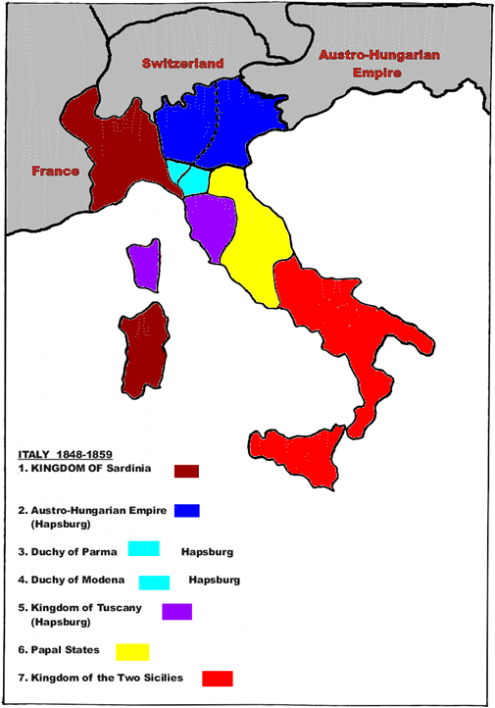

Italy Before Unification…
Dominated by Foreign Powers
People identify themselves with local regions (ie: I’m Tuscan… Not I’m Italian)
Than → Napoleon invade and Nationalism!
  Italian based on – geography, shared history, language & culture.
  End trade barriers

Slide 27
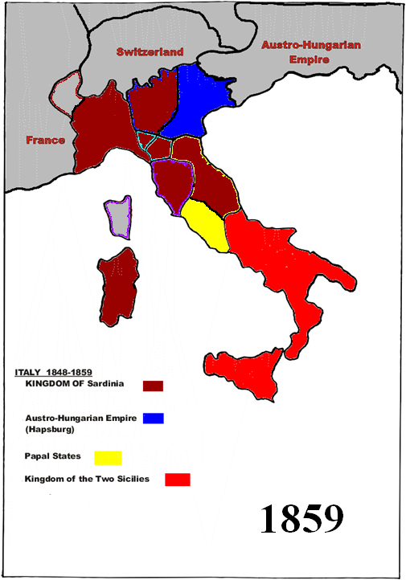
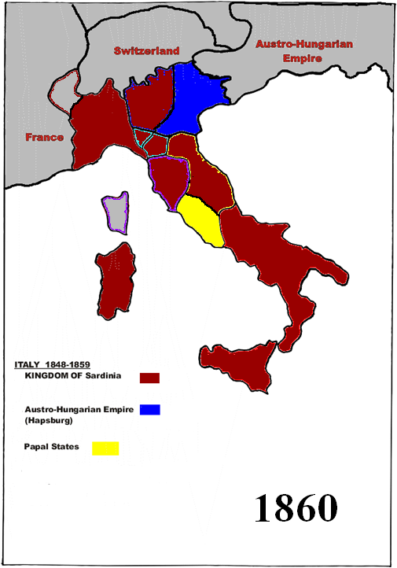

Slide 28
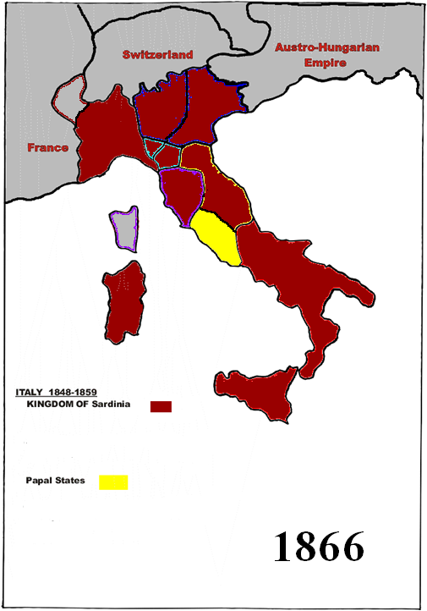
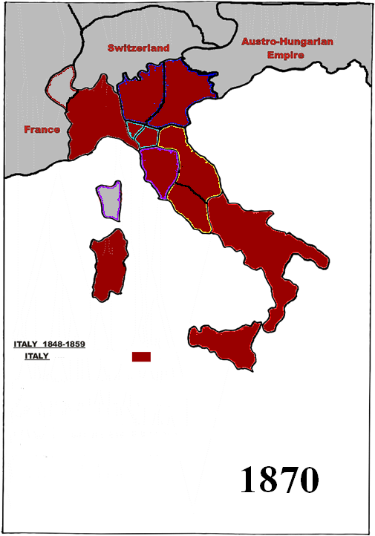

Slide 29
Unifying Italy
Timeline
1860
1866
1849
1870
1861
1831
1855
1830
1840
1850
1860
1870
1852
1859

Slide 30
Italian Unification – Organize the following events
Victor Emmanuel names Count Cavour prime minister
Mazzini founds Young Italy
Cavour defeats Austria, annexes Lombardy. Nationalist overthrow northern Italian States
Mazzini helps set up a revolutionary republic in Rome
Sardinia joins Britain & France in Crimean War
Garibaldi and “Red Shirts” capture Sicily & Naples. Turns regions over to Emmanuel
Emmanuel II is crowned king of Italy. Cavour dies
France withdraws troops from Rome – Italy Unified
Venetia is added to Italy

Slide 31
Unifying Italy
Timeline
1860
Garibaldi and “Red Shirts” capture Sicily & Naples. Turns regions over to Emmanuel
1866
Venetia is added to Italy
1849
Mazzini helps set up a revolutionary republic in Rome
1870
France withdraws troops from Rome – Italy Unified
1861
Emmanuel II is crowned king of Italy. Cavour dies
1831
Mazzini founds Young Italy
1855
Sardinia joins Britain & France in Crimean War
1830
1840
1850
1860
1870
1852
Victor Emmanuel names Count Cavour prime minister
1859
Cavour defeats Austria, annexes Lombardy. Nationalist overthrow northern Italian States

Slide 32
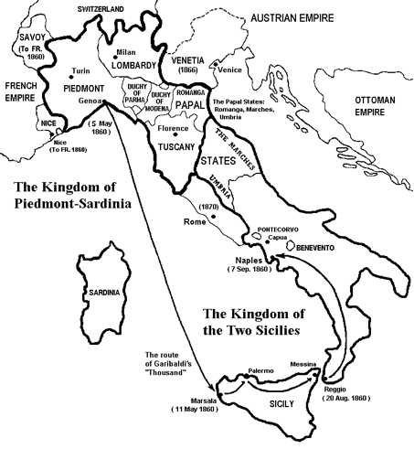
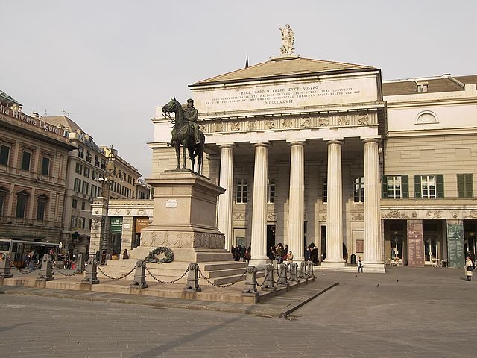
Garibaldi on a horse in Genoa

Slide 33
Italian Unification
 | Italy
Main leader(s) & philosophies | Several Leaders 1. Count Cavour (Prime Minister of Sardinia) believes in Realpolitik & wants more power for Sardinia 2. Giuseppe Garibaldi (nationalist revolutionary)
Figurehead - | Victor Emmanuel (King of Sardinia) Viva Verdi!
Main foes or obstacles | Domestic: strong regional ties make nationalism hard, Socialist & Anarchists cause unrest Foreign: Foreign Countries (Austria) own parts of Italy
Chronology of events & wars | 1855 The Crimean War 1859 Sardinia (backed by France) provokes a war with Austria 1860 Garibaldi’s invasion of Sicily 1861 add Venetia, 1870 add Rome
outcomes | Divisions between Northern & Southern Italy still a problem Popes angry at losing Rome = urge Italian’s to not support their gov’t (this is a problem until WWII!) Gov’t extends suffrage & social programs, difficult industrial transition causes emigration in early 1900s

Slide 34
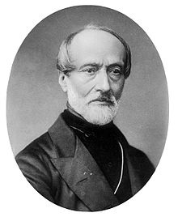

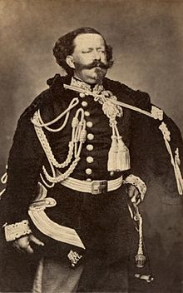

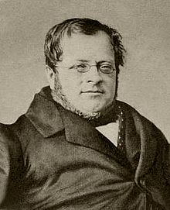
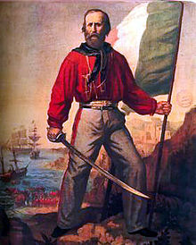
Close but not quite… 1830s-50s
Giuseppe Mazzini –
  leader of “young Italy”– 1849 leads a failed revolt, Exiled for the rest of his life
Leaders of Italian Unification: 1850s-70
Victor Emmanuel (King of Sardinia)
Count Cavour (Prime Minister of Sardinia)
  Goal is to end Austrian power in Italy
  1858 – nationalist leaders begin overthrowing their leaders & joining Sardinia
Giuseppe Garibaldi
“ideas grow quickly when watered with the blood of martyrs”
Revolutionary: “Read Shirts” ‘invade’ Sicily & Southern Italy (supported by Sardinia) & gives the land to Victor Emmanuel declaring him ‘King of Italy”

Slide 35
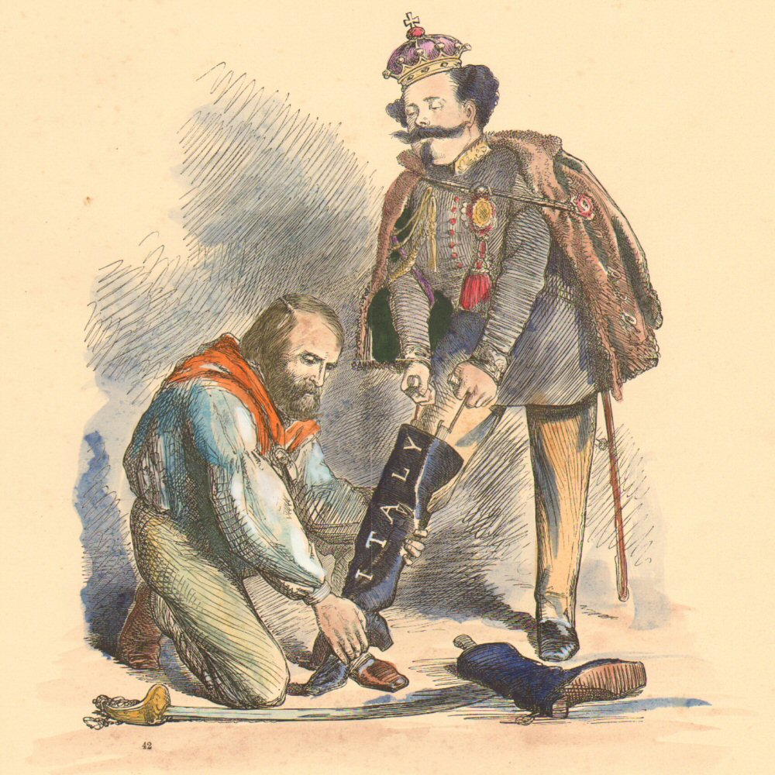
Warm-Up
Examine the Cartoon and answer the following questions:
1. Based on your knowledge of the events leading to the unification of Italy, what event is being represented in this cartoon?
2. What do you think Garibaldi means when he suggests that King Emmanuel use ‘more Powder’ to force on the boot?
3. How is Garibaldi’s suggestion similar to Bismarck’s use of ‘blood and iron’ to unify Germany?
4. Draw a conclusion – based on your observation how do you think the artist feels about the unification of Italy?
Right leg in the Boot at last by John Tenniel
Garibaldi. “If it won’t go on sire, try a little more Powder.”

Slide 36
Warm-Up #3
Examine the Cartoon and answer the following questions:
Italian Unification -
1. What do you think Garibaldi means when he suggests that King Emmanuel use ‘more Powder’ to force on the boot of Italy?
2. How is Garibaldi’s suggestion similar to Bismarck’s use of ‘blood and iron’ to unify Germany?
3. Draw a conclusion –How does the artist feel Italy must be unified? (explain using detail from cartoon)
- based on your observation how do you think the artist feels about the unification of Italy?
Right leg in the Boot at last by John Tenniel
Garibaldi. “If it won’t go on sire, try a little more Powder.”

Slide 37
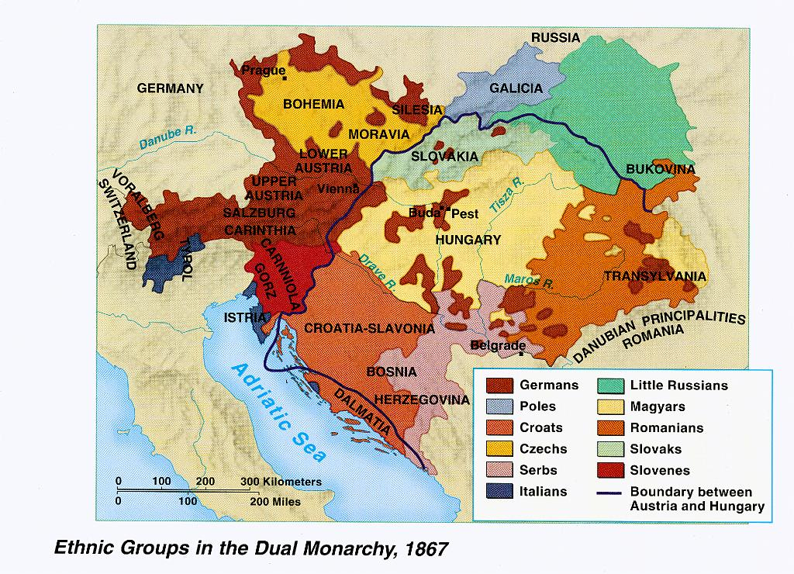
Balkan Ethnic Groups
How many ethnic groups are there in the Balkans in 1867?
Why do you think competing interests in the Balkans led the region to be called a ‘powder keg?”
Nationalism helped unify Italy and Germany. How might Nationalism also break apart countries? (reference the definition of nationalism)

Slide 38
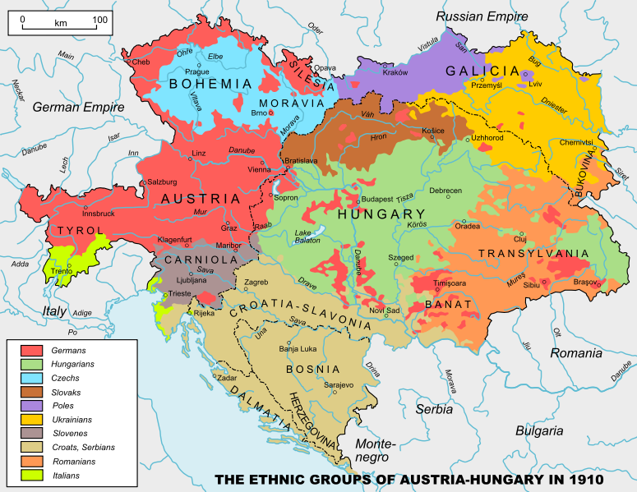
Ethnic

Slide 39
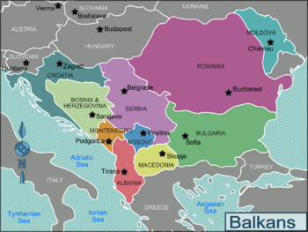
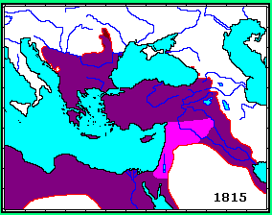
The Balkans
In the 1800s many of the Balkan states declared their independence from the Ottoman Empire.
the region becomes Very unstable and conflict ensues

Slide 40
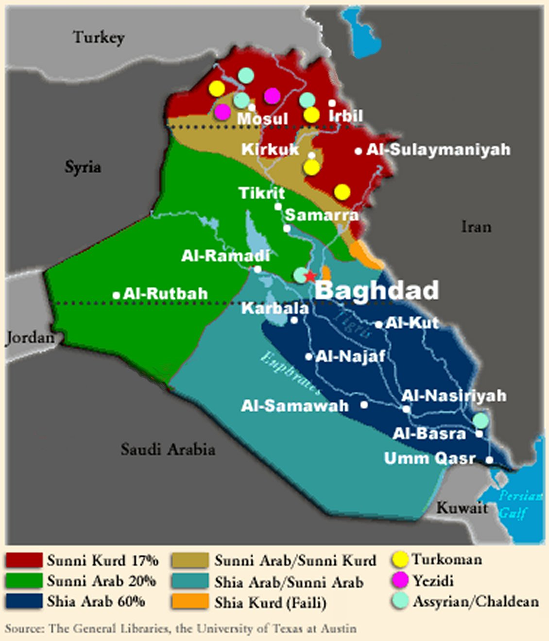
Understanding Nationalism Today
Discussion – how would our knowledge of what happened to Austria-Hungary and the Ottoman Empire help us understand current events in Iraq?
-Using the map what problems might Iraq being facing in trying to create a unified country?

Slide 41
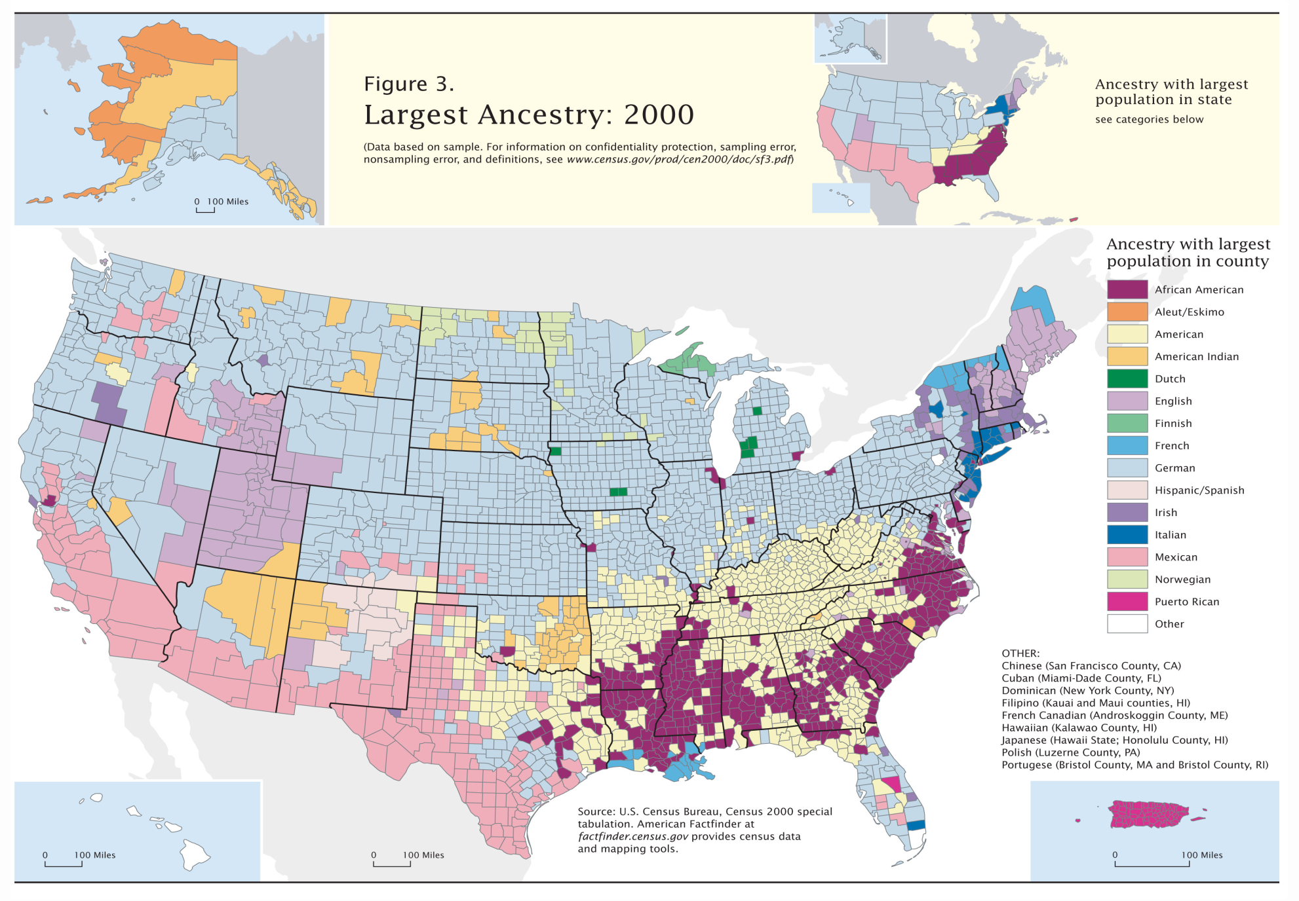
1. The United States also has many ethnic groups, why do you think the US has not suffered from Revolutionary nationalism the way that the Balkans and Iraq have?
- What event(s) in recent years has brought out nationalistic feelings among Americans?

Slide 42
Nationalism Threatens the Stability of Europe
Nationalism = some New Countries strengthened and some weakened
New Countries formed:
Nationalism encourages revolts
*European powers want Ottoman lands but Balkan States want their independence (‘powder keg’)
1.Austria-Hungary a multiethnic, divided State
2.Ottoman Empire Collapses – Balkan States nationalist revolt
1830 and 1848 – nationalistic revolts in Europe for independence and reform
Italy , Germany , Dual Monarchy of Austria-Hungary
New countries want more power
Begin competing with one another
Imperialism…

Slide 43
Written Response
How have people used nationalism as a basis for their actions: (pg. 709 in textbook)
  Read the three actions associated with nationalism & use this information to help you answer question #2.
2. Write two lists answering the following question.
- Considering the major changes to European boundaries, and the methods that leaders used to complete boundary changes, do you think nationalism was a constructive or a destructive force in this era?

Slide 44
Nationalism
Constructive
Destructive

Slide 45
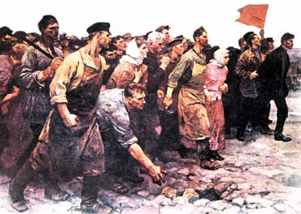
Russia
Events Leading to Revolution
1815: Russia is the largest nation in Europe, lead by tsar Alexander II
1856: Russia loses the Crimean War, and the people demand reforms.
  Tsar Alexander II frees the serfs, but he is assassinated in 1881
1881: Tsar Alexander III is repressive, reversing many of the reforms, tries to force Russia to industrialize and modernize
1905 – series of protests by workers turn deadly as the government violently represses the marches (Bloody Sunday)
Revolution
Results of the Revolution
1905, October: Tsar Nicholas announces reforms – October Manifesto
  (freedom of speech, assembly, & person) & summons the Duma (elected national assembly)
1906: the first Duma met but is dissolved when they criticized the Tsar.
1906: Peter Stolypin made Prime Minister
  Arrests, Executions and Pogroms (Persecutions or massacres against Jews) followed
  Some limited reforms: land reforms, improved education
1911: Stolypin assassinated
1914: Russia still an autocracy but with many problems

Slide 46
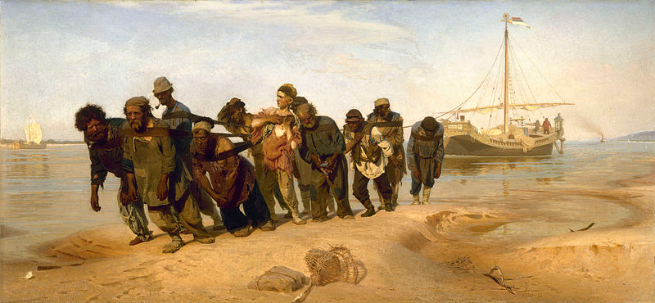
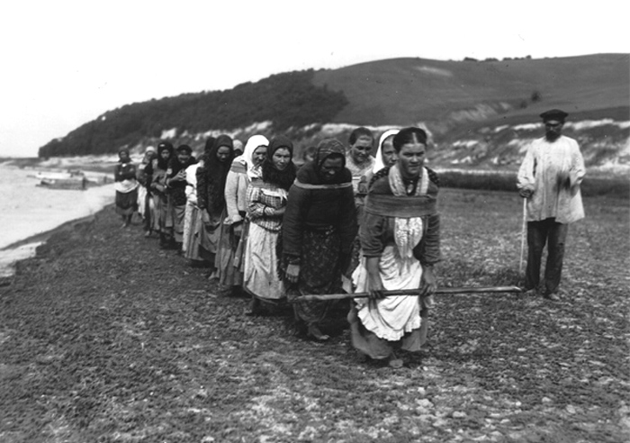
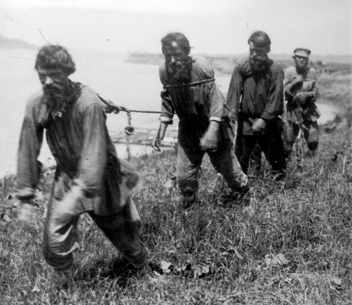
Barge Haulers on the Volga or Burlaki
by the Russian realist painter Ilya Repin

Slide 47
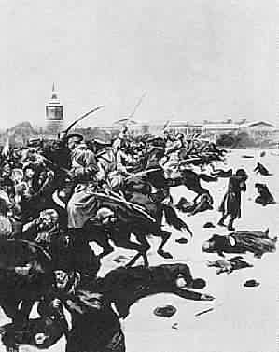
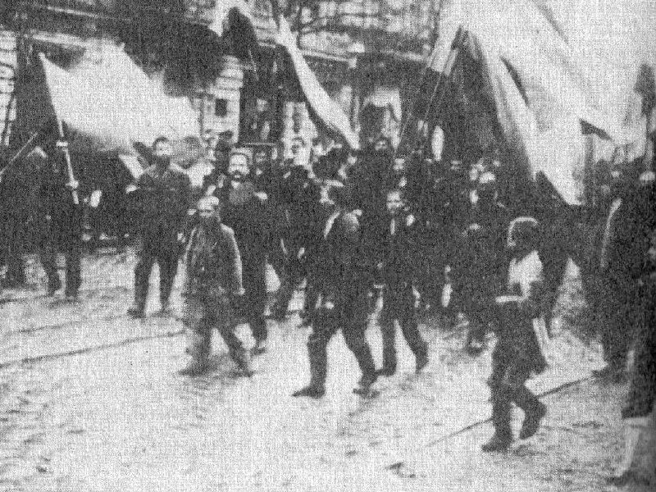
Bloody Sunday (1905)

Slide 48
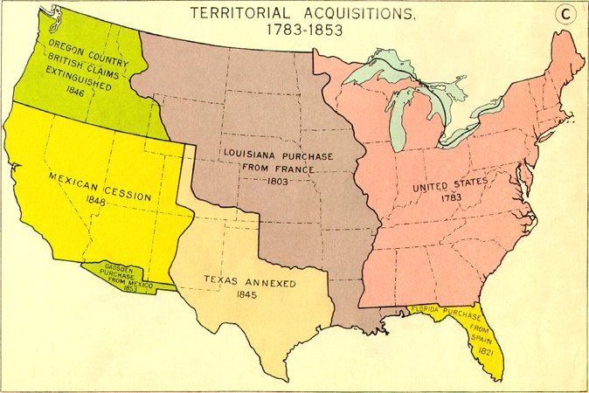
Expansion of the United States
Territorial Changes (Ch 23, Sec 4)
Key events:
  1803 Louisiana Purchase
  1846- 1848 Mexican War
  1849 California Gold Rush
  1861 -1865 Civil War
  1867 Purchase of Alaska
  1869 Completion of the Transcontinental Railroad
  1898 Spanish-American War; Hawaiian islands annexed

Slide 49
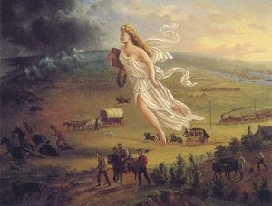
Why did the United States Expand?
Nationalism Definition:
The desire for national advancement or independence
The policy of asserting the interests of one’s own nation
Manifest Destiny: the idea that the US was destined to spread across the entire continent
  Manifest Destiny b/c to Americans this ideas was readily apparent (manifest) and inevitable (destiny).
  Policy of expansionism continued even after the US controlled the continent
(Imperialism)

Slide 50
Nationalism Review…
Review Questions:
How did Nationalism inspire or affect the individual or event that you and your partner received?
Nationalism
  A strong identification with a group (ex: I AM an American)
  Devotion and loyalty to one’s own nation; patriotism
  The desire for national advancement or independence
  The policy of asserting the interests of one’s own nation
Terms
Definition
Manifest Destiny
The Balkans
Victor Emmanuel
Count Cavour
Otto von Bismarck
Realpolitik
October Manifesto
Giuseppe Garibaldi
William I
Giuseppe Mazzini
Bloody Sunday
Zollverein
Blood & Iron Speech
destined to spread across the entire continent
The powder keg of Europe
King of Sardinia
Prime Minister of Sardinia
Prime Minister of Prussia
Practical politics over principled politics
Reforms in Russia by Tsar Nicholas II
Revolutionary leader of the “Read Shirts”
King of Prussia/ Kaiser of Germany
Failed Revolutionary leader of “young Italy”
The spark that started the Russian Revolution in 1905
Economic Union within the German Union
Bismarck’s plan to unify the German States

Slide 51
Key Elements For the Development of a Nation
Shared History or heritage
Shared culture / sense of group identity
A vision for a united future
http://online.missouri.edu/exec/data/courses/2309/public/lesson01/lesson01.aspx
http://www.historyhome.co.uk/europe/bismarck2.htm
http://www.americanrhetoric.com/moviespeechesa-f.htm

Slide 52

Nationalism in Austria-Hungary
1840 – Austrian Cities industrialize and bring worker discontent and desire for reforms
1848 – Nationalist revolts break out, but are crushed by Austrian Government
1859 – 1866 Austria defeated by France, Sardinia, and Prussia (lose land)
1867 – Austro-Hungarian Compromise creates semi-independent states of Hungary – Austria (the Dual Monarchy)
  Tension between different ethnic groups increase (Slavic people want independence)
  Examples of independent, ethnic nations in the Balkans (Serbia, Greece) break from Ottoman Empire

Slide 53
I. The "Spirit" of German Nationalism: Richard Wagner and the Ring Cycle Operas
Richard Wagner (1813-83) is one of the most controversial composers of the nineteenth century. His talent and place as one of the great romantic composers is often overshadowed by his virulent anti-Semitism, having claimed that Jews were "the evil conscience of our modern civilization." He was also an ardent German nationalist. The Ring Cycle operas, perhaps his greatest works, were composed and first staged in 1876, shortly after Germany unified. They were intended to develop a mythic national history for the new empire, which had no actual political history on which to construct a national identity. Early in his career, Wagner identified with the socialist movement and supported the Revolution of 1848 in Germany. Following the 1848 upheavals, Wagner penned his essay, "Art and Revolution," in which he argued that the task of the artist is to effect political change through artistic expression. The career and music of Richard Wagner offer a unique interdisciplinary approach to the romantic aspect of German nationalism.

