Slide 1
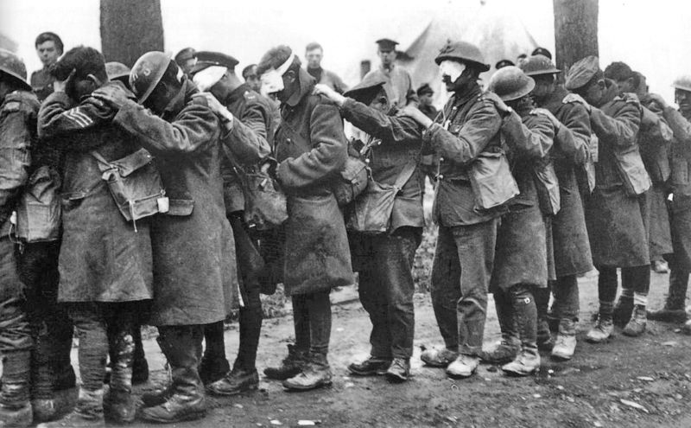
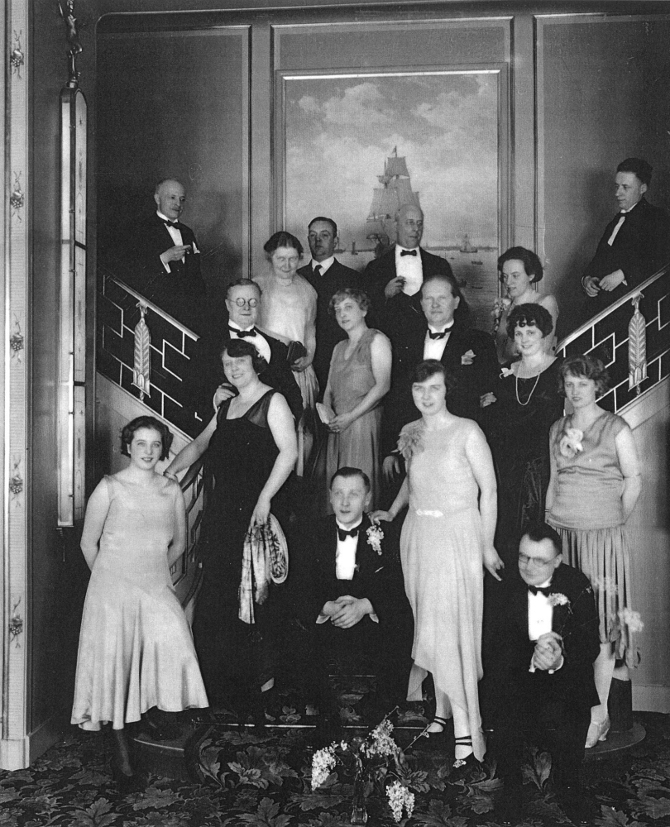
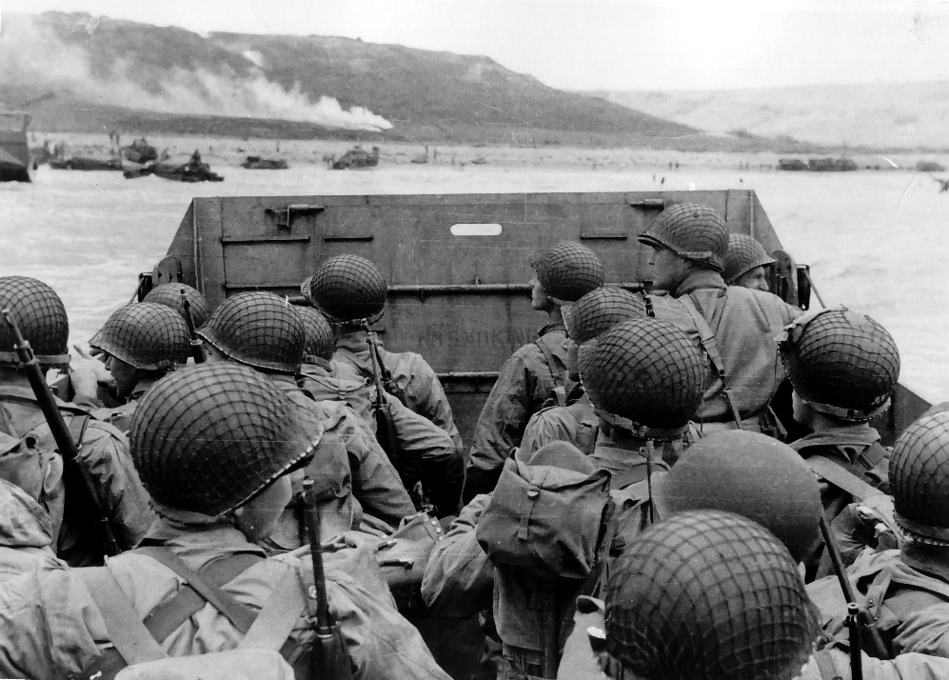
Unit 7 – World Wars
WW1 (1914 – 1918)
Interwar Years
WW2 (1939 – 1945)

Slide 2
World War 1 – Causes
Summary
Long-Term Causes =
Continued increase in tension between European Powers over resources, political powers.
Antiquated view of warfare (belief that war was necessary to make a country stronger)
World War b/c of imperialism & colonialism
Causes of the War:
-Militarism
-Alliance System
-Imperialism
-Nationalism
Trigger Moment: Assassination
of archduke Franz Ferdinand of
the Austro-Hungarian Empire.

Slide 3
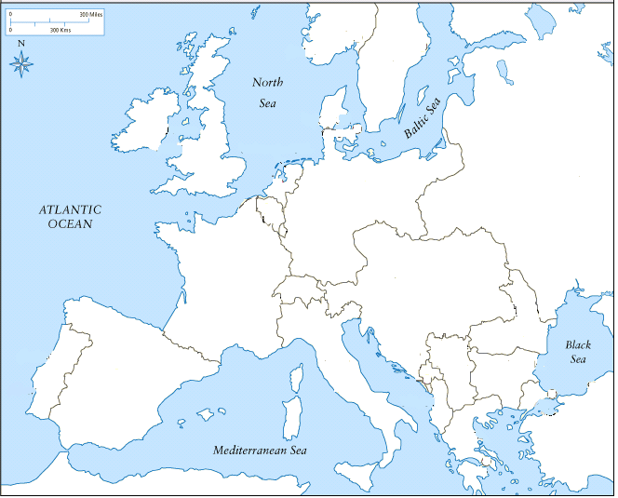
World War 1

Slide 4
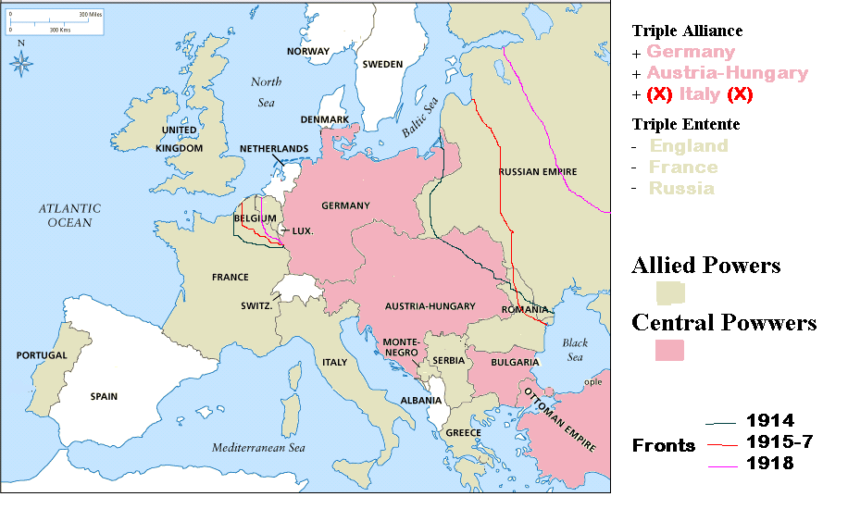
The Alliance System

Slide 5
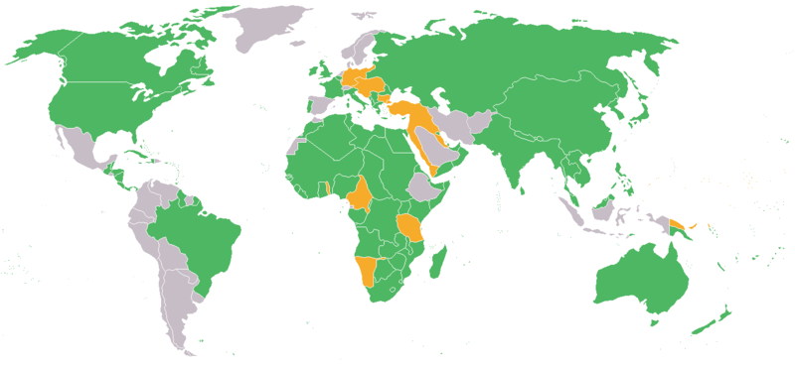
‘The Great War’ – A World War
Allied Powers in Green
Central Powers in Yellow
Neutral Countries in Gray

Slide 6
Timeline of Events
June 1914
Assassination of Archduke Francis Ferdinand of Austria-Hungary.
July 1914
Blank Check: Germany gave Austria-Hungary a “blank check”
Ultimatum: Austria-Hungary made demands to Serbia.
Serbia accepted most of the ultimatum, but rejected some parts.
Austria-Hungary declared war on Serbia.
Willy- Nicky telegraphs: telegraphs between Russia and Germany.
Mobilization: Russia and Germany get ready for war
August 1914
August 1stGermany declared war on Russia.
Russia called on France, its ally. France gave Russia a “blank check.”
Germany demanded that France back down.
August 3rd France refused to back down, so Germany declared war on France.
August 4th Germany’s Schlieffen Plan = Germany attacks France through Belgium.
England declared war on Germany
August 6th Austria-Hungary declares war on Russia
October 1914
Ottomans joined the Central Powers
May 1915
Both alliances bargained with Italy, but Allies offer the sweeter deal

Slide 7
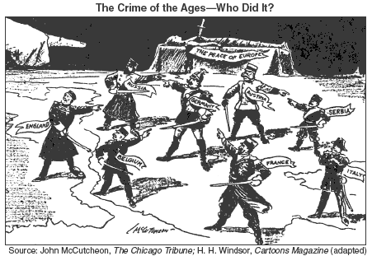
The Outbreak of War
Between August 1 and August 6 Germany, Russia, France, A-H and Britain had all declared war on one another. Historians still debate who (nation/leader) or what force caused WWI. Each country pointed their finger at someone else.
Is it important to lay the blame for the war on one group or nation? Why or why not?
Consider the causes of war we have discussed. Which do you think is the most significant and why? (Explain your answer)
Examine the cartoon – what does this drawing suggest about the outbreak of WWI?

Slide 8
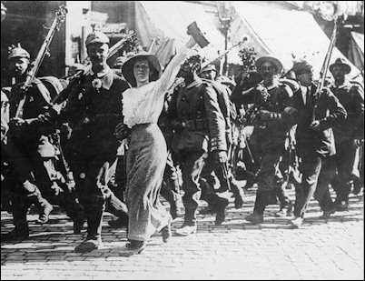
Vision of War Prior to WW1
“There were parades in the street, flags, ribbons, and music burst forth everywhere, young recruits were marching triumphantly, their faces lighting up at the cheering…as never before, thousands and hundreds of thousands felt what they should have felt in peace time, that they belonged together.”
“The Rushing Feeling of Fraternity” Stefan Zweig
Short Response Questions:
How do Europeans respond to the outbreak of war?
What reasons are given for why Europeans responded this way?
(use specific information from the reading and the video clip to explain your answer)

Slide 9
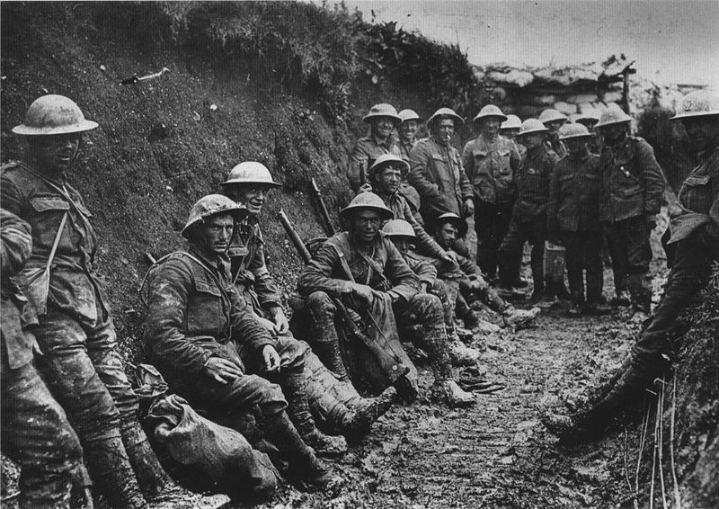
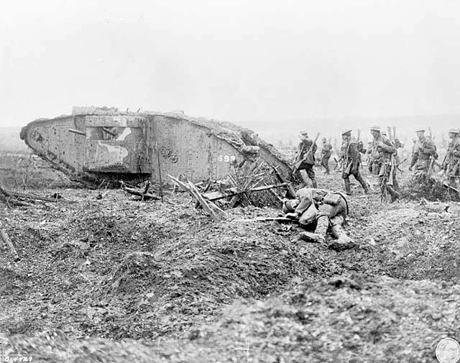
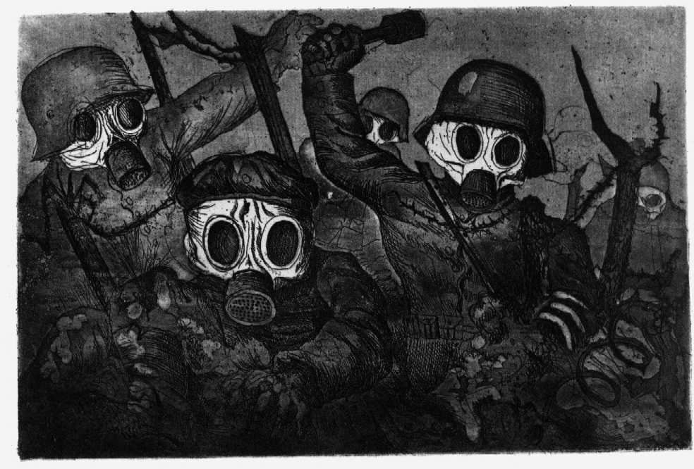
Characteristics of An Industrial War
More than 70 million military personnel mobilized (60 million Europeans
Over 9 million combatants killed, over 21 million wounded
About 6.8 million civilian deaths
Unlike most wars before this the majority of military deaths were caused by combat (improved weapons)
Otto Dix, Storm Troopers During a Gas Attack, 1924

Slide 10
Marne (1914) Western Front | Fought outside of Paris French and British troops vs. Germany Allied powers dig trenches (this is the beginning of the stalemate)
Tannenberg (1914) Eastern Front | Germany vs. Russia Fought just inside of Germany (Russia advanced early in war) Germany repulsed Russians and inflicted heavy casualties Russia begins a retreat that would last most of the war….
Gallipoli (1915-6) | -Ottoman Empire joined the Central Powers -Allies landed in the Dardanelles (connect with ally Russia), and can’t get off the beached for 10 months! Very heavy casualties - Ottomans cause Allies to retreat (more stress on Russia)
Somme & Verdun (1916) Western Front (Stalemate) | Germany/ Allies wanted to break the stalemate Verdun: Massive German assault that lasted 11 months, 700,000 casualties Somme: massive English and French assault, 1 million casualties (both battles indecisive – nothing changes)
The Grand Offensive (1918) Battle of the Argonne Forest | Final Allied push, an attack on all parts of the Western Front (US has joined) Allies were able to push back the Germans, who had low morale Led to Germany accepting an armistice – a cease fire http://www.pbs.org/greatwar/maps/index.html

Slide 11
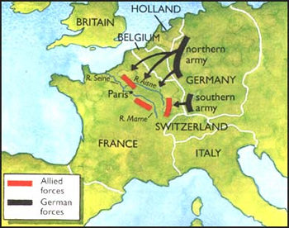
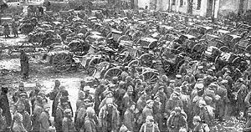
Opening Clashes
Marne 1914
Western Front (France)
Tannenberg 1914
Eastern Front (Russia)
Fought outside of Paris
French and British troops vs. Germany
Allied powers dig trenches (this is the beginning of the stalemate)
Germany vs. Russia
Fought just inside of Germany (Russia advanced early in war)
Germany repulsed Russians and inflicted heavy casualties
Russia begins a retreat that would last most of the war….

Slide 12
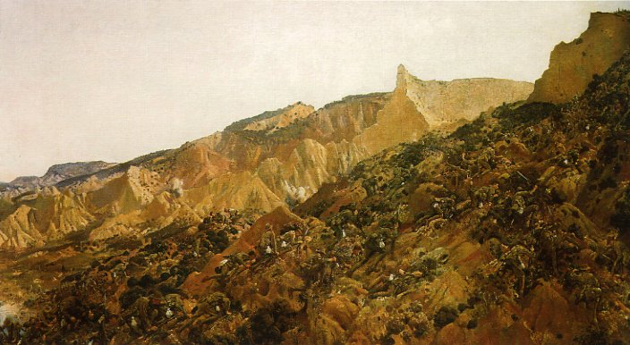
Devastating Battles
Gallipoli (1915-6)
Somme & Verdun (1916) Western Front (Stalemate)
-Ottoman Empire joined the Central Powers
-Allies landed in the Dardanelles (connect with ally Russia), and can’t get off the beached for 10 months! Very heavy casualties
- Ottomans cause Allies to retreat (more stress on Russia)
Germany/ Allies wanted to break the stalemate
Verdun: Massive German assault that lasted 11 months, 700,000 casualties
Somme: massive English and French assault, 1 million casualties
(both battles indecisive – nothing changes)

Slide 13
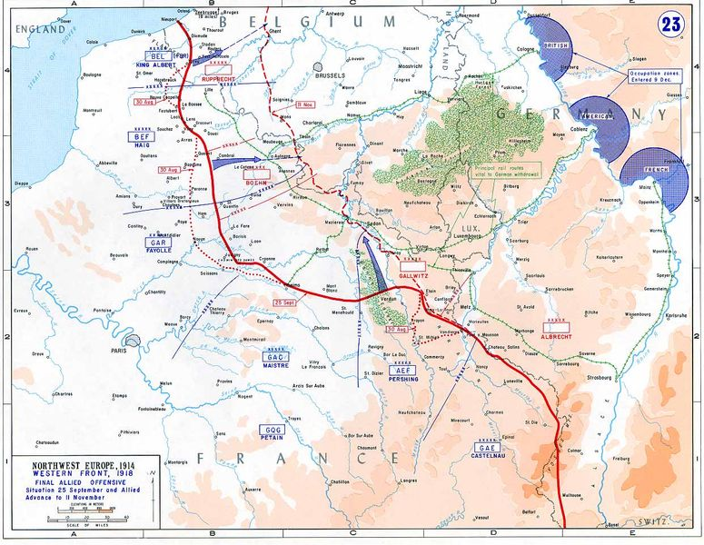
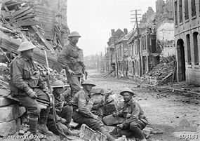
Final Battle
The Grand Offensive (1918) Battle of the Argonne Forest
Final Allied push, an attack on all parts of the Western Front (US has joined)
Allies were able to push back the Germans, who had low morale
- Led to Germany accepting an armistice – a cease fire

Slide 14
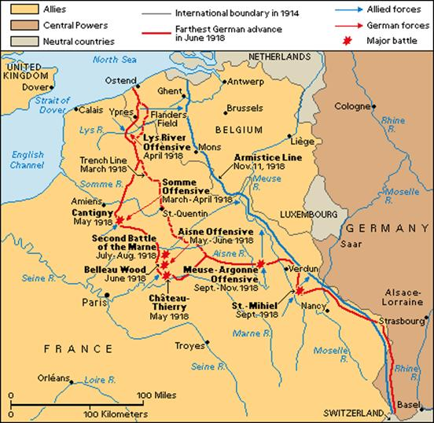
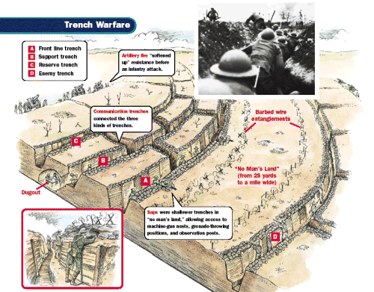
Tactics and Strategies of the Great War

Slide 15
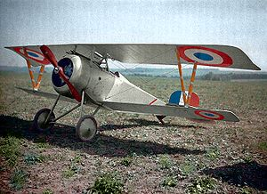
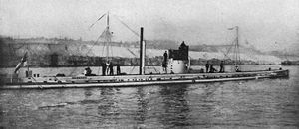
Overcoming the stalemate with new ideas (Weapons)
New(ish) technology and tactics
Air: zeppelins, airplanes- mainly used for reconnaissance & bombing supply lines
Sea: steel battleships, cruisers, u-boats; convoys; naval mines
Land: tanks, siege howitzers, machine guns, poison gas, mortars, grenades

Slide 16
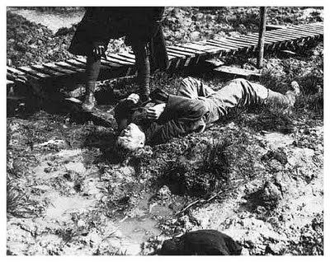
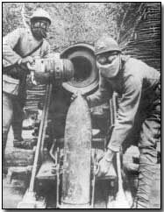
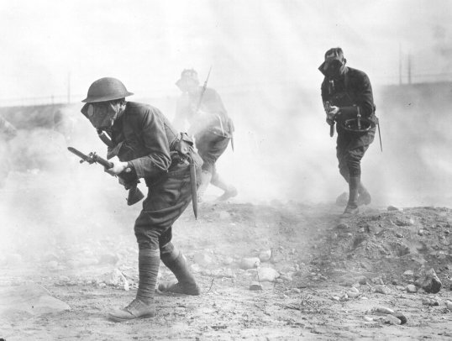
Mustard gas, an almost odorless chemical, was distinguished by the serious blisters it caused both internally and externally, brought on several hours after exposure. Protection against mustard gas proved more difficult than against either chlorine or phosgene gas.
Although it is popularly believed that the German army was the first to use gas it was in fact initially deployed by the French. the first poison gas however - in this instance, chlorine - came on 22 April 1915, at the start of the Second Battle of Ypres. The use, on both sides, quickly escalated.
Types of Posin Gas developed –
- Chlorine
- Phosgene
- Mustard

Slide 17
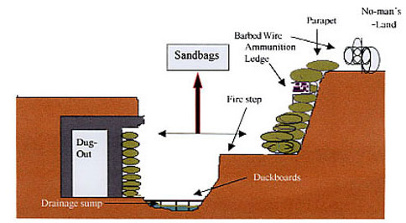
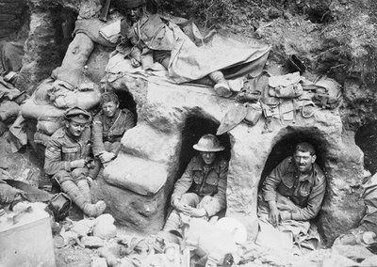
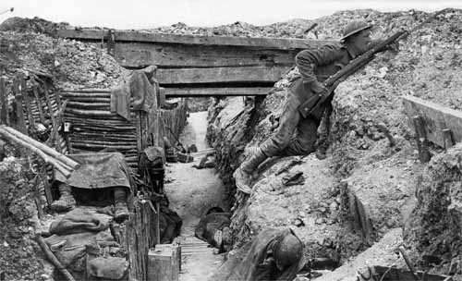
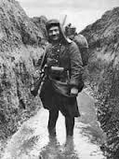
Impact of New Weapons

Slide 18
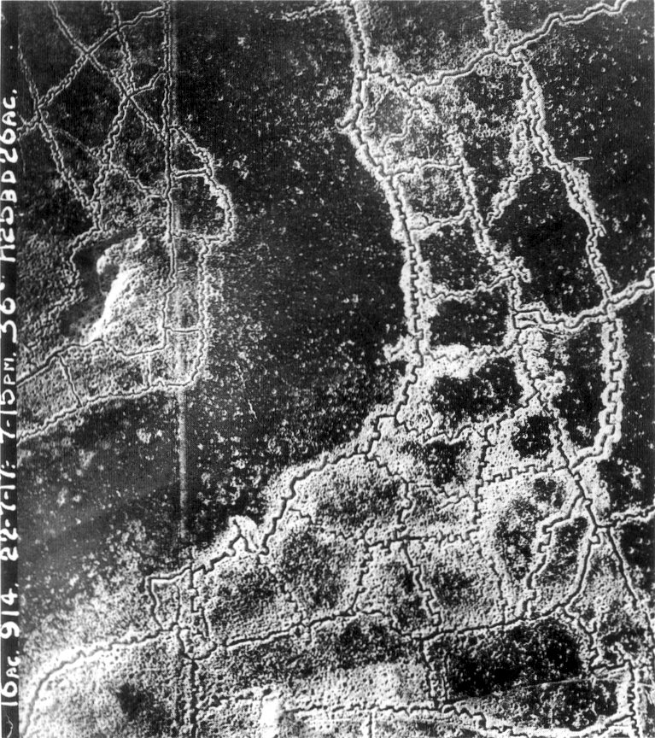

Slide 19
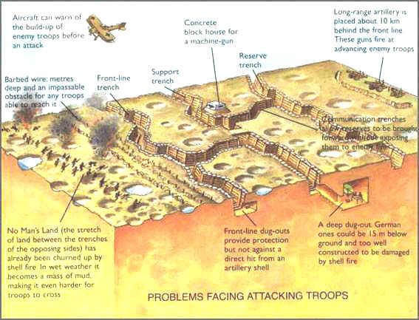

Slide 20
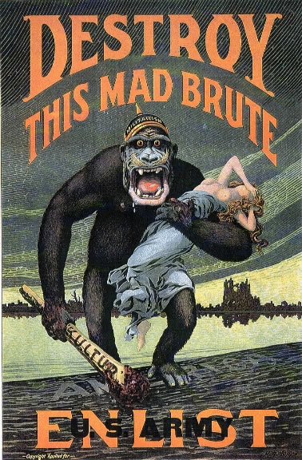
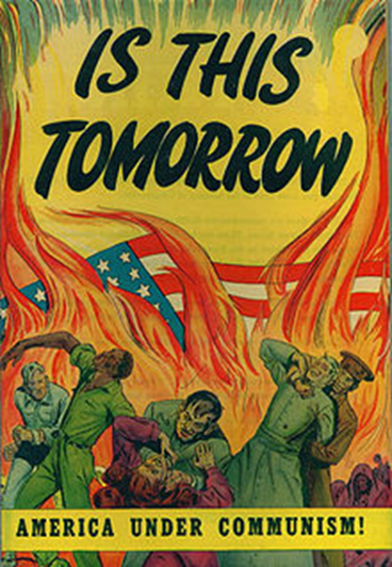
Not Just Weapons…
Censorship
many government made “agreements” w/ the press to cover in positive ways
Mail was read and censored, especially if it was going to the troops
Propaganda: spreading of ideas to promote a cause or damage an opposing cause
Total war: shift all of a nation’s resources into war efforts
Included changing civilian factories into military factories
Brought mechanical, civil, etc. engineers into the military → led to war tech
Unrestricted sub warfare: even attack civilian ships if they help war effort
(Lusitania) – ‘civilian’ ship sunk by the Germans

Slide 21
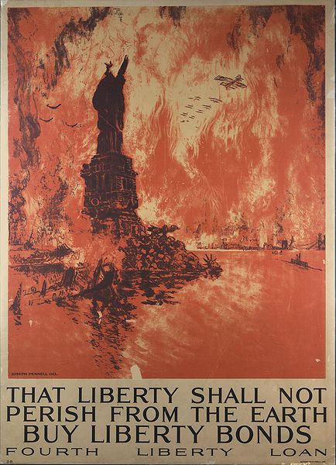
Not Just Weapons
Conscription: drafting civilians into the military
All nations involved had a military draft
Raised spending and taxes to buy more war goods
War (liberty) bonds: like an IOU
government sold bonds (slips of paper) to people & companies
the government was expected to repay this money, plus interest/fee, after a certain period

Slide 22
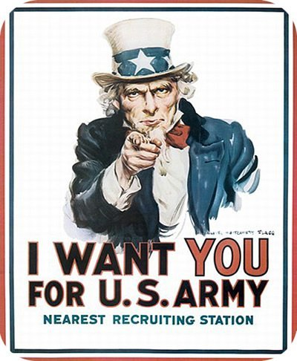
US Involvement
America was hesitant
Many German-Americans had sympathy for Germany
Irish-Americans did not want to join and help the British
But…America joined the Allies for numerous reasons
1. English-American connection existed
2. Germany’s unrestricted submarine warfare killed American civilians
3. Zimmerman Note (1917)
Germany wrote to Mexico – ‘fight US and you can get Southwestern lands back.’ *England intercepted and gave to America, who joined the war

Slide 23
On The Home front Government Sponsored Propaganda
Propaganda = the spreading of ideas to promote a cause or damage an opposing cause
*purpose is to quickly persuade and advocate an agenda
Elements of Propaganda –
Imagery – appealing imagery (pictorial or descriptive)
Repetition – a message must be continuously repeated so that it will take hold in the collective consciousness
Simplicity – message should be quickly understood (the simple lie always conquers the complex truth)
Sentiment – message must contain as little detail as possible but should appeal to a strong emotion (ex: sympathy, anger, pride, etc…)

Slide 24
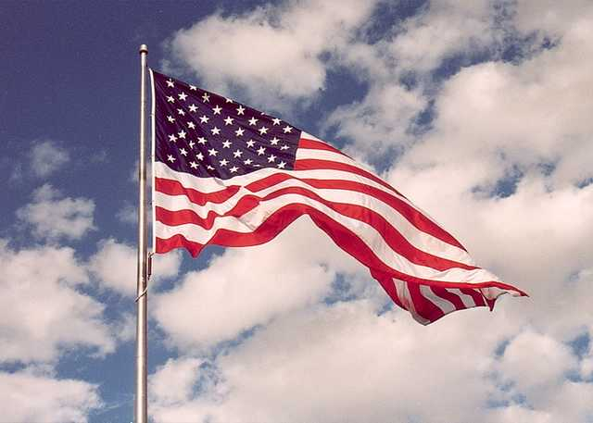
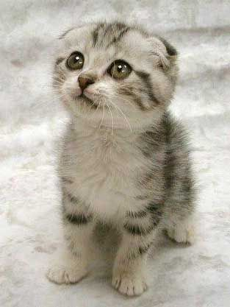
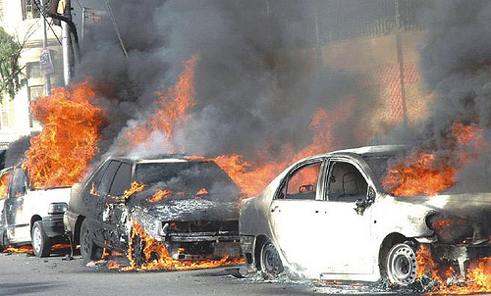
1. Imagery
Quick Association – what emotions or terms do you link to these images?

Slide 25
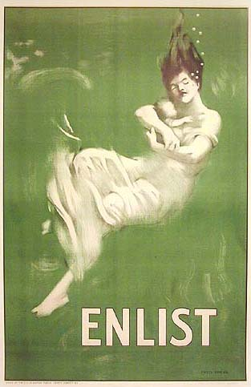
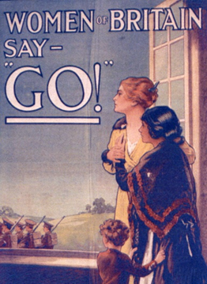
What types of Imagery are used in these posters?

Slide 26
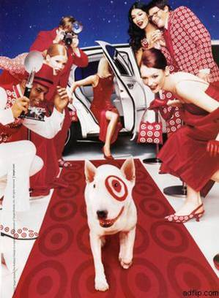
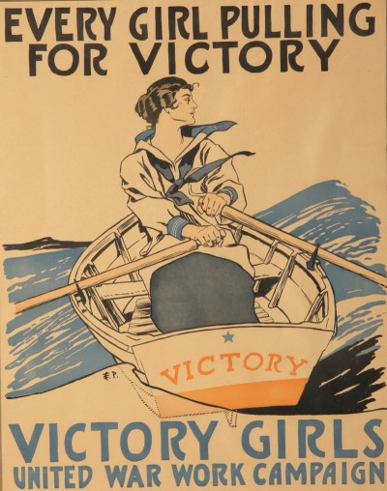
2. Repetition
What is being repeated in each of these ads?

Slide 27
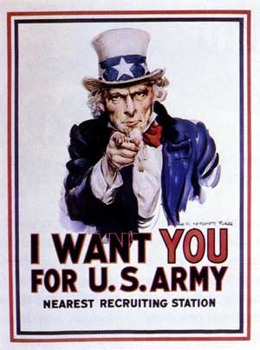
3. Simplicity
Quick read: What is the message of these ads?

Slide 28
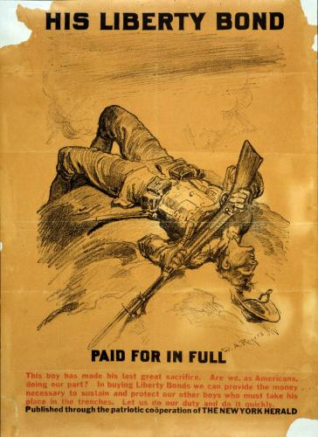
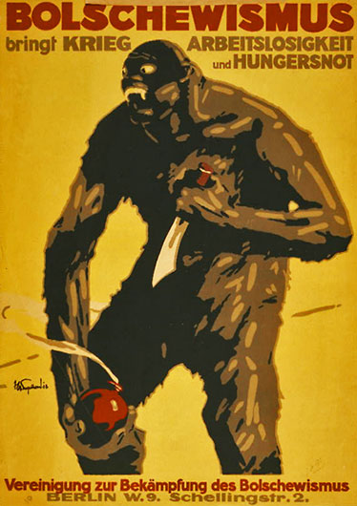
4. Sentiment
What are the emotions that each of these posters or ads are provoking?
German Anti- Russian Propaganda Poster

Slide 29
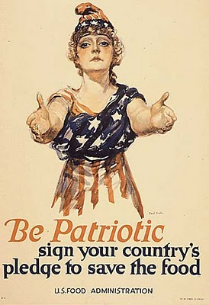
The War on the Home front
What is the message of this poster?
How is the US Food administration trying to persuade people to believe in this message?
List specific details for the poster as evidence…

Slide 30
Critically Examine Propaganda
Title / words of Poster:
Analysis of Poster:
Use the chart below to list people, objects, and activities found in the cartoon or picture:
People/ Animals Objects Activities
Write a brief description of the artwork:
What is the message of this poster? Propaganda is the spreading of ideas to promote a cause or damage an opposing cause
How does your poster fulfill this description?
On a separate piece of paper create your own propaganda poster. Make sure that your poster includes a message (what do you what the viewer to think or feel) and a specific topic (recruitment, war bonds, etc…).

Slide 31
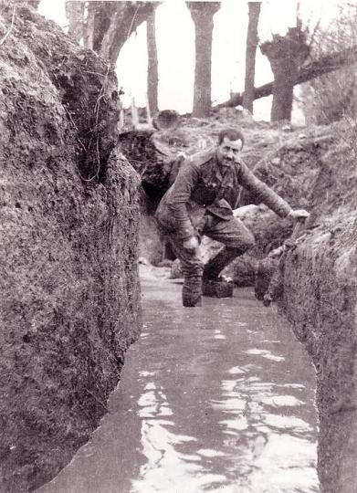
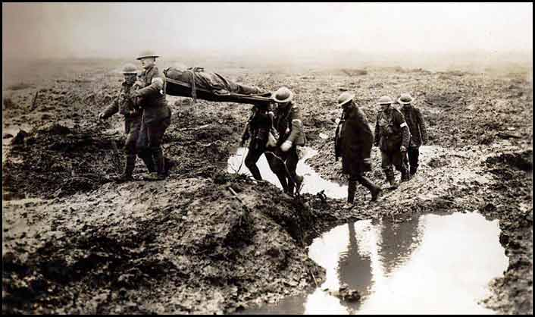
Ending the War
US involvement was a huge morale boost
Germany was running out of money and new recruits (it was using 15 and 16 year olds)
Requested an armistice, or break in fighting, on November 11, 1918
Proposed peace agreement – Germany thought they would get Wilson’s 14 points

Slide 32
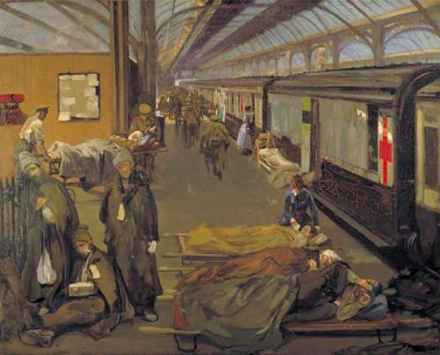
What were the Characteristics of WW1?
“The Lost Generation”
the WW1 Generation. A high proportion of whose men were killed during the war and so this term is often used to help define the lost potential of this group.
ALSO – a group of writers & artists from this generation who established reputations during the 1920s.
*The generation was “lost” in the sense that its inherited values were no longer relevant in the postwar world
Battle front: Poems & literature from the War
Step 1: Same Poem Questions:
Summarize your poem and paraphrase the main idea: (What is the poem about)
How does your poem portray warfare? (use specific quotes or phrases to support your answer)
Step 2: New group Poetry Jam
Do any of the poems have a similar themes or topics?
Why do you think that the generation who fought World War 1 is known as the Lost Generation? How do these Poems reflect the definition of the Lost Generation?
John Lavery - The Wounded at Dover (1918)

Slide 33
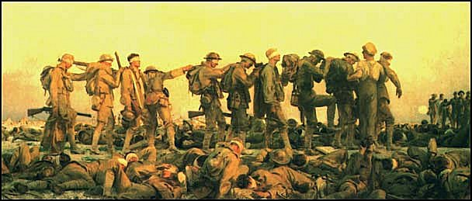
Impact of World War One “The Lost Generation”
Gassed by John Singer Sargent

Slide 34
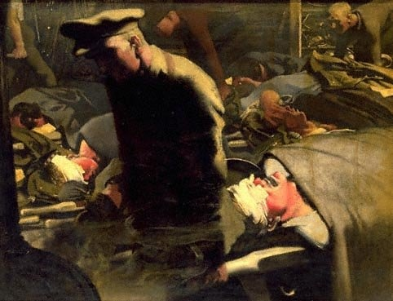
Eric Kennington, Gassed and Wounded, 1918

Slide 35
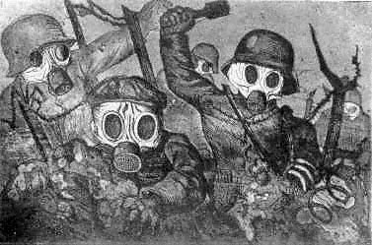
Otto Dix
Masques à gaz by Henri de Groux.

Slide 36
Effects of the War on the Landscape
Tasks:
Go to my website
2. Examine the slideshow of pictures and answer the questions on how the war impacted Europe.
*Once you are done open your Notes packet to Page 7a: Woodrow Wilson’s 14pts and the Versailles Conference Provisions.
*Read the two excepts and answer the 4 questions on the next page.

Slide 37
The Zone Rouge (the Red Zone)
1,200 square kilometres (460 sq mi) of land in northeastern France that was physically and environmentally destroyed during the First World War.
Because of hundreds of thousands of human and animal corpses and millions of unexploded ordnance that contaminated the land, some activities in the area such as housing, farming or forestry, were temporarily or permanently forbidden after the war by French law.
Some towns were never permitted to be rebuilt.
Restrictions in the zone rouge still exist today although the controlled areas have been greatly reduced.

Slide 38
World War 1 Trenches today
Over 90 years later, trench outlines can still be seen in northern France. Shell fragments, grenades, etc. are plowed up every year.

Slide 39
Paris Peace Conference
Wilson’s Peace
Actual Decision
G.B. and France ensure Germans must pay heavy reparations for starting the war
Closed Diplomacy (all discussion happen behind closed doors)
Proposal Fails, each nation wants its own piece of the resource pie
Much of the Middle East is attached to Britain as a Mandate
Difficult to unite diverse ethnic groups… led to unrest and creation of unstable nation states
Ex: Iraq: Eventually leads to the US invasion in 90s and 2003
Clustering of ethnic groups in the Middle East and Europe. Especially if they hate each other
Peace without Victory
Open Diplomacy
Freedom of the Seas and Free Trade
End Colonialism
Self Determination
Vs.
Wilson hailed as a hero at the conference – idealistic plan BUT modern liberalistic model is established at conference (Collective Security Model … later becomes the UN)

Slide 40
Civilians as Casualties of War
World War 1 saw an unprecedented number of civilian casualties
Examples:
Armenian Genocide
The Ottoman Empire ‘deported’ 2 million Armenians – 1-1.5 million were killed or starved in Concentration camps.
One of the first modern large scale, systematic, and plan killing of a ethnic group of people
Of this photo, the United States ambassador wrote,“ Scenes like this were common all over the Armenian provinces, in the spring and summer months of 1915. Death in its several forms—massacre, starvation, exhaustion—destroyed the larger part of the refugees. The Turkish policy was that of extermination under the guise of deportation."

Slide 41
Civilians as Casualties of War
Deaths by alliance and military/civilian. Most of the civilian deaths were due to war-related famine.

Slide 42
Indirect Effects from the War
Influenza Epidemic:
Spring of 1918 a new flu strain mutates and kills between 50 – 100 million people worldwide
Killed mostly young adults (2-20% of these infected died), 27% (500 million people) of world infected
World War I did not cause the flu, but the close troop quarters and massive troop movements hastened the pandemic.
probably both increased transmission, augmented mutation b/c of increased travel
Soldiers and sailors among the first hit with the virus.

Slide 43
Short Answer Response: Ticket Out
1. How did the nature of warfare change during World War One to become classified as modern or industrial warfare? (Give specific examples or supporting detail for your answer)
Take into consideration the tactics of this war, using specific battles as examples and the effects of these tactics. Also consider the effect the war had on the home front and how civilians became involved in the conflict.

Slide 44
Germany After the War
“Vengeance! German people! Today the shameful peace has been signed in the Hall of Mirrors at Versailles. Forget it not! There where, in the glorious year 1871, the glorious German Reich was reborn in its ancient splendour, there German honour is today interred (buried). Forget it not! By labour without relaxation and without flagging the German people will reconquer the place which is their due among the nations! Therefore, revenge for the ignominy (disgrace) of 1919!”
- The Deutsche Zeitung, June 28, 1919
The following quote is from a German newspaper the day the Treaty of Versailles was signed.
How did Germans view the Treaty of Versailles?
What excerpt from the quote can you use to support your answer?
If the treaty was such an disgrace why didn’t Germany go back to war?
Consider the effects of WWI that we examined yesterday.
What did the Allies (France and England in particular) want when writing the Treaty of Versailles? Does this quote suggest they achieved their goal?
Germany 1918 – Statistics from the War
-523,000 civilians dead (250,000 more after the armistice from starvation)
1.7 million dead, 4.2 million wounded soldiers
Owed 132 billion German marks [$400 billion today] in reparations

Slide 45
Write a Paragraph answering the following question: How did World War 1 Change Warfare? Consider the following questions below to help you answer the question and Give Specific Examples…
Battle Front
Home Front
Tactic of the war?
Use specific battles as examples
Effect of these tactics?
How did civilians become engaged in the war effort?
How did our view of warfare change because of World War 1?
Use specific examples in your answer

Slide 46
Immediate Effects
1. A generation of Europeans are killed or wounded
2. Dynasties fall in Germany, Austria- Hungary, and Russia
3. New Countries are Created
4. The League of Nations is established to help promote peace
How did WW1 help set the stage for WW2:
None of the Causes of WW1 are addressed at the end of the war. MAIN are still significant and are going to remain problems after the war.
The Treaty of Versailles blames/ punishes Germany and is going to set the stage for Germany to radicalize in the interwar period
US isolates themselves after the war & other world powers are not able to address WW1 problems
Long-Term Effects
1. Many nations feel bitter and betrayed by the peace settlements
. Problems that helped cause the war – nationalism, competition - remain

Slide 47
What are the causes of the Russian Revolution?
Why was Russia such a hard country to rule in 1900?
Why did a series of Revolutions begin in Russia?
Russia 1900-1924

Slide 48
Russia:
An overview
6.5 million sq mi. – 1.8 times the size of the US
11 different time zones.
Beyond the Ural Mountains, Russia was a wild place with frontier settlements.
150 million people but 50% were not ethnic Russians, (Ukrainians, Poles, Armenians, etc..)
Petrograd and Moscow undergo industrialization but majority of country Rural farmland.
The factory workers lived in filthy, crowded, disease-ridden dormitories near the cities.
Peasants lived in wood and straw houses, slept on beds of straw and wore coarse woollen shirts. The poorest had sandals made of tree bark.

Slide 49
Population
4 out of 5 Russians were peasants. They had a hard life and there was often starvation and disease.
Nobles made up 1% of the population but owned almost 25% of the land.
If peasants protested (for example during famines), the Tsar would use his feared Cossack soldiers against them.

Slide 50
1929 – Stalin
became the
sole ruler
of the USSR
and created a
totalitarian state
1900 – Tsar Nicholas II
ruled over the Russian
Empire with absolute power
1922 – Lenin established the Union of Soviet Socialist Republics under the control of the Communist Party
1904 – Russia suffered
humiliating defeats
in a war against Japan which led to protests and calls for reform
The Russian
Revolution
1918 - 1921 – Bolsheviks (Reds) fought and won a civil war against the White armies
1905 – After Bloody Sunday, Nicholas II agreed to allow a Duma, or legislature for the people
Nov 1917 – Lenin and the Bolsheviks took control in Petrograd and ended the republic
March 1917 – Revolts in Petrograd
forced the Tsar
to abdicate and a provisional republic was established
1914 – Russia entered WWI and quickly suffered heavy losses
in major defeats to Germany along the Eastern Front.

Slide 53
Russia under Communism
1918 onwards: The Communists change Russia. For example, some Russians get electricity for the 1st time.
1926: Stalin comes to power. Huge statues of him are put up, leading his people to victory!

Slide 54
Interwar Years 1919 - 1939

Slide 55
Postwar Issues
Country | Politics | Foreign Policy | Economics
Britain
France
United States

Slide 56
Examine the Post War Challenges of Britain, France and the United States
Country | Politics | Foreign Policy | Economic
Britain | Political Struggles result in: Conservative party becomes powerful (power of the workers to strike limited) | - Wanted to change the treaty (too harsh on Germany) - IRA (Irish republican army begins a guerrilla war until most of Ireland granted homerule in 1922 | -Workers strike and Britain goes in to debt -High unemployment
France | To Many political Parties created political instability | Goal is to Secure borders against Germany (Maginot) | -Improved economy and low unemployment
United States | “The Red Scare” = ‘Radical’ rounded up & deported. Amer. moves toward isolation | Kellog Brand Pact signed to ‘outlaw’ war Attempt to at disarmament fails to limit army size | -Unemployment high (by 1938 it was at 17%)

Slide 57
Heinrich Hauser ‘With Germany’s Unemployed’ 1932
“An almost unbroken chain of homeless men extends the whole length of the great Hamburg-Berlin highway. It is the same scene for the entire 200 miles. I saw them, in groups of 50 to 100, attacking field of potatoes, & staggering towards the lights of the city. I know what cold &hunger are. I know what it is to spend the night outdoors or behind the thin walls a of a shack through which the wind whistles. I have slept in holes, in haystacks, under bridges, and in the forest.”
Questions:
Which country had more than 25% unemployment during the Great Depression?
Hypothesize at least two possible reasons that explain why Germany had the highest unemployment rate.
What sort of conditions does the Great Depression cause in Germany? (use the quote to help explain your answer).

Slide 58
The Great Depression – the Stock Market Crash
Stock market crash of 1929
Stocks were growing in cost, even though their value didn’t
(No one really looked at what the companies were earning, just stock prices)
Speculation was more important – people were caught up in quick profits
Many began to sell of stocks when they realized stocks weren’t actually valuable
Richest investors (who also owned companies) lost most money
Companies suffered
Rich owners were pinched and had to cut back costs (jobs)
Working class people lost jobs & could no longer buy any goods
Banks closed
Working class people could not repay for goods bought on credit
Farmers went into foreclosure when they couldn’t pay mortgages
Loans taken to buy stocks on margin could not be repaid
What would happen in Europe if US banks and industries failed?

Slide 59
Rise of Fascists and a Totalitarian State
Fascism: centralized, authoritarian state that glorifies the state and does not value the individual human rights
Totalitarian state: a one party dictatorship in which the state controls all aspects of society (Total control)

Slide 60
Italy’s Problems
World War 1 caused many Problems in Italy:
650,000 dead and 1 million wounded
The Versailles treaty does not give Italy any land (even colonies)
War sends the cost of living up since the army needed so many supplies
Radicals (the Communist Party) begins to organize & take political power
What does Mussolini’s Fascism offer Italy?

Slide 61
Benito Mussolini
Fascism offers:
Promised a stronger government that could deal with problems
Promised to rebuild Italy’s military (ending unemployment)
Mussolini’s personal army, the Blackshirts, beat up Communists

Slide 62
Mussolini organized a group of followers - veterans and other angry Italians – into the Fascist Party in 1919.

Slide 63
Used Violence & Fear to intimidate political opponents
Mussolini organized his followers into a personal army called the Black Shirts. They believed violence better than voting
Black Shirts attack peasants, broke up strikes, smashed printing presses of opposition, broke up socialist meetings

Slide 64
Demonstrations of Strength & Seize Power
The Fascists rallied at Naples and announced they would demand changes from the government. Mussolini’s March on Rome - 1922
When Mussolini arrived in Rome, the king of Italy gives Mussolini the job of prime minister out of fear

Slide 65
Consolidate Power & Suppress Opposition
Mussolini used his new power in Italy to strengthen his own party. By 1925 he was rigging elections, censoring the press, jailing opposition
In 1929, Mussolini made a deal with the pope, Pius XI, to get the support of the Catholics. Church gets independent Vatican
Mussolini took control of the economy: His Fascist Party controlled industry, agriculture, trade. Lower class did not benefit, as wages stayed low.

Slide 66
What did Mussolini do with absolute Power?
Took control over the economy
Rebuilt industry and transportation
Censored and arrested any groups that opposed him
Outlawed the Communist Party

Slide 67
The Rise of Hitler
Why would the German people accept and support a Fascist and Totalitarian leader like Adolf Hitler?
What Problems did Germany Face after WW1?
German Inflation
Define Inflation:
Why did inflation impact German citizens so harshly but NOT French citizens?
Why couldn’t French Citizens buy goods in Germany and bring them back to France?
How do you think the Germans feel about the French after reading Hemingway’s description of the French?
(use a specific quote to support your answer)

Slide 68
Great Depression in Germany

Slide 69
Hyper Inflation in Germany

Slide 72
The Great Depression
Major causes
America was wealthier than Europe
Dawes Plan: America lent money to Europe to rebuild
Helped Germany afford reparations
Tariffs
America blocked European goods from being bought
Europeans bought cheap, mass produced American goods
What would happen if the rich decided to stop investing in businesses?
What would happen if America could no longer lend money to Europe?

Slide 74
Germany’s Problems After WW1
General Distrust and Dislike of new German Government (the Weimar republic)
Many political parties (including Communists) who fought for power.
Lost a ton of land (Rhineland) & industrial power
War costs & reparation high
Inflation surged when Germany simply printed more money
Relied on US loans to rebuild (stock market crash…)

Slide 75
Rise of Hitler

Slide 76
Germany (the Interwar Years)
1. Immediately after WWI, Germany faced major problems: political parties argued, many Germans disliked the government for signing the Treaty, need to pay reparations drove inflation and high unemployment.
This young woman is burning German Marks because the paper burned longer than the wood you could buy with the money.

Slide 77
2. Hitler joined the Nazi Party in 1919, eventually becoming its leader. He used his own personal fighting squad, the Brown Shirts, to intimidate his opponents.
3. In 1923, inspired by Mussolini, Hitler tried to lead an uprising in Munich against the Weimar government. He failed and was sent to jail.

Slide 78
4. While in jail, Hitler wrote Mein Kampf, a book that became the basis for Nazi Party ideas. He blamed Jews, communists, and businessmen for losing WWI.
5. Hitler was released from jail and continued to rally supporters. Many people joined Hitler at the beginning of the Great Depression because he promised jobs and to end the Treaty.

Slide 79
Nazi Party Election Results
Date | Votes | Percentage of Votes | Seats in Reichstag | Background
May 1924 | 1, 918,300 | 6.5 | 32 | Hitler in prison
December 1924 | 907,300 | 3.0 | 14 | Hitler is released from prison
May 1928 | 810,100 | 2.6 | 12
September 1930 | 6,409,600 | 18.3 | 107 | After the financial crisis
July 1932 | 13,745,800 | 37.4 | 230 | After Hitler was candidate for presidency
November 1932 | 11,737,000 | 33.1 | 196
March 1933 | 17,277,000 | 43.9 | 288 | During Hitler's term as Chancellor of Germany
“Our Last Hope”

Slide 80
6. The German government gave Hitler the title of chancellor in 1933 because it was thought that he could end the fighting between parties in the government.
7. Hitler became a dictator by suspending rights, censoring the press, disbanding opposition political parties, and to killing any Nazis that may have been disloyal. His secret police – Gestapo – and elite troops – SS – terrorized any opposition.

Slide 82
8. Hitler launched major public works projects to put people to work making highways, houses, or to plant forests. He also built up weapons (against Treaty).
9. The Nazi Party and Hitler’s government tried to bring unity in Germany through hatred of Jews. The Nuremberg Laws were passed to limit the rights of Jews and Jews were attacked during the Kristallnacht

Slide 83
Why would the German People accept and support a Fascist/ Totalitarian leader like Adolf Hitler?
Reasons?
https://www.youtube.com/watch?v=jFICRFKtAc4

Slide 84
Ideologies
Nazi Ideology
Fascist Italy
Authoritarian, Totalitarian system
Variety of fascism includes racism and anti-Semitism (prejudiced against Jews)
Promised to rescue Germany from the Depression
Works programs, social welfare…
Argued that Germany's survival required a ‘New Order’
Wanted a German empire in Europe
Need land mass, resources, and expansion of population to compete with other powers
Authoritarian, Totalitarian system
supports the state over the individual
Human rights not valued
Expansionist
(wanted to create a “New Roman Empire”)
Anti-Communists
Favors businesses over workers
Favors violence and force to change governments

Slide 85
Compare and contrast the actions, philosophies, and character traits of Mussolini and Hitler
Nazi Party Under Hitler
Italian Fascists Under Mussolini
Philosophies-
Philosophies-
Philosophies-
Actions –
Actions –
Actions –
Character Traits -
Character Traits -
Character Traits -

Slide 86
Compare and contrast the actions, philosophies, and character traits of Mussolini and Hitler
Nazi Party Under Hitler
Italian Fascists Under Mussolini
Philosophies-
Variety of fascism includes racism and anti-Semitism (prejudiced against Jews)
Wanted a German empire in Europe (3rd Reich)
Philosophies-
wanted to create a “New Roman Empire”
Favors violence and force to change governments
Philosophies-
Fascists / Totalitarian
*State over the Individual (glorification of the State)
Actions –
-Use of Violence (Black/ Brown Shirts) to squash opposition and spread fear
-Dictators who limit the rights of their people
Actions –
- Originally tried force but fails
- Gained power through elections (43% of vote in 1933)
Actions –
- Gained power by force (March on Rome 1922)
- King gives Mussolini job out of fear
Character Traits -
Character Traits -
Character Traits -

Slide 87
Nazi Propaganda
Nazi propaganda was crucial for their rise to power and for the implementation of their policies. For example:
pursuit of total war
the extermination of millions of people in the Holocaust.
Hitler wrote 2 chapters on the necessity of propaganda in Mein Kampf
Propaganda messages became the ‘official truth’ under Nazi government

Slide 88
Tasks
Read the quote from Hitler’s Mein Kampf and answer the questions
Questions:
What does Hitler believe are the essentials to Propaganda?
According to Hitler, why is Propaganda necessary?
When is Propaganda not effective?
Analyze the Propaganda poster using the Analysis Worksheet
Once you have analyzed the posters write a paragraph explaining how these posters represent how Hitler used Propaganda.
(use details from the posters and quotes from Mein Kampf to explain your answer)

Slide 89
World War II

Slide 90
29-1: Prelude to World War II
COUNTRY | ACTS OF AGGRESSION
Japan
Italy
Germany
Spain
Japan invaded Manchuria in 1931 and created a new colony
Japan started the Second Sino-Japanese War when it attacked China in 1937
Mussolini sent Italian forces to conquer Ethiopia in 1935-6
Rome-Berlin-Tokyo Axis supported aggressive expansion
Hitler defiantly re-armed Germany and created the Wehrmacht
Nazi forces occupied the Rhineland in 1936 and violated the Versailles Treaty
General Franco led his Fascists to victory in the Spanish Civil War with German and Italian help in 1939

Slide 91
29-1: Steps to War in Europe
GERMAN ACTS OF AGGRESSION
March 1938
September 1938
March 1939
September 1939
Hitler forced the Anschluss, or union of Austria with Nazi Germany, which was another explicit violation of the Versailles Treaty
At the Munich Conference, Britain and France appeased Hitler’s demand concerning the Sudetenland which was in Czechoslovakia
Hitler broke his promise made in the Munich Conference and invaded the rest of Czechoslovakia; Britain and France officially ended their policy of appeasement
The German Wehrmacht used blitzkrieg, or lightning war, to invade Poland leading Britain and France to declare war

Slide 92
Appeasement
Basically:
Allies refused to act to prevent attacks, but were disgusted with war
WHY?
Fear of new technology & losses in WWI
Pacifism after WWI: League of Nations, Washington Naval Treaty, Kellogg-Briand Pact
Economic depression – no money to fight
Belief that Fascism could balance out communism in Russia
Misinterpreted what Hitler wanted
Some in England thought Germany was justified due to Treaty of Versailles
As a result of Appeasement Axis powers got to test new strategies and technology and expand their power

Slide 93
29-2: The Axis Advances
September 1939 – Germany invaded Poland
April 1940 – Blitzkrieg campaigns against Denmark and Norway
May 1940 – British rescued troops at Dunkirk
June 1940 – France surrendered to Germany
September 1940 – Mussolini ordered forces into Egypt
October 1940 – Italian forces invaded Greece
September 1940 to June 1941 – Battle of Britain
June 1941 – German Wehrmacht invaded the Soviet Union
September 1941– Siege of Leningrad began
December 1941 – Japan attacked Pearl Harbor

Slide 94
Major Targets
- England – Battle of Britain & Operation Sea Lion (1940)
Luftwaffe continuously bombed England
Plan was to bomb into submission
Then land an amphibious invasion
(Invasion never happened since England rallied in its “darkest hour”)
Germany continued to launch naval attacks at will in the Atlantic
Unrestricted submarine warfare

Slide 95
Surviving the Blitz
1. Where would people take shelter during the bombing?
http://www.telegraph.co.uk/news/newstopics/world-war-2/8021316/How-it-felt-to-shelter-from-the-Blitz.html
WWII propaganda film
What is the purpose of this film?
http://www.telegraph.co.uk/news/newstopics/world-war-2/8208926/Unseen-images-of-Manchester-Christmas-Blitz.html

Slide 96
Major Targets
- Russia – Operation Barbarossa (1941)
Germany had planned since early in the war to attack Russia
Goals:
Lebensraum – living room for the German Third Reich
Access to more resources to defeat remaining allies
Eliminate communism
Expanded deep into Russia, stalled at major cities
Leningrad, Stalingrad held out for months of guerilla warfare
Blitzkrieg stalled and died

Slide 98
World War 2 in 1941

Slide 99
Turning the Tide
- Russian Front
Fall/Winter 1941-42
German infantry and artillery were stuck in the mud caused by fall rains
German army froze outside of Moscow (guns froze, soldiers got frostbite – no winter supplies)
Leningrad refused to surrender even after 2.5 years of being sieged
Workers continued to make tanks, etc –now even faster than Germany
Summer 1942 – Spring 1943
Battle of Stalingrad: an epic urban battle w/ fighting in the streets
Russians encircled the German army and forced surrender
Battle of Kursk: Russians planned effective defenses against the German blitzkrieg
Germans lost 300 tanks in one day, Russians gained the upper hand
http://www.history.com/shows/wwii-in-hd/videos/world-war-ii-battle-of-stalingrad#world-war-ii-battle-of-stalingrad

Slide 100
Turning the Tide
African Theater - 1942
Rommel had the British and French on the run to Egypt
Was running out of supplies and reserves, which Hitler needed for Russia
The British stopped his advance at the Battle of El Alamein in Egypt
This turned the tide against Germany and Italy in Africa
Italian Campaign –
Summer 1943
Allies invaded Sicily and then at the Battle of Salerno and quickly won a victory
King Victor Emmanuel III forced Mussolini to step down
Italy sued for peace with the Allies and declared war on Germany
Fall 1943 – 1945
Germany fought Allies on Italian soil and resisted until the end of the war
Mussolini was captured by Ally-sympathetic Italians and executed (dead body hung in public)

Slide 101
Turning the Tide
Western Front (France, Belgium, Netherlands)
Summer 1944
W/ German forces diverted to Italy and Russia, Allied sought to launch into France
June 6(D-Day): The Battle of Normandy
stormy, unexpected locale, amphibious landing = Germans caught off guard
Winter/Spring 1945
Russians pushed into the eastern half of Germany
US/English pushed into western Germany
Germany surrendered into de facto peace in April and May
Allies struck a de jure peace in June 1945

Slide 102
Phases
Persecution
Laws established to restrict rights
Pogroms such as kristallnacht
Confinement
Ghettos and 1st Camps
Mass Murders
Eisengruppen (death squads) traveled followed the main German Army and kill thousands of individuals
(deemed to time consuming & bad for the German soldiers)
Final Solution
Mass murders in death camps

Slide 104
Shoah “destruction”
In 1994, Steven Spielberg founded the Survivors of the Shoah Visual History Foundation (original title), a nonprofit organization established to record testimonies in video format of survivors and other witnesses of the Holocaust.
http://www.youtube.com/user/USCShoahFoundation?blend=24&ob=5

Slide 105
Survivor’s Stories Questions:
MAUS II: a survivor’s tale | Survival in Auschwitz
1. How did the main character reunite with his wife in Auschwitz? | 1. What does the sign above the entrance to Auschwitz say?
2. What camp were the women in? How was this camp different from Auschwitz I? | 2. Why wouldn’t the German translator ask the guards the prisoners questions?
3. What type of work did the prisoners do in the camp? | 3. Why does the author say that he has ‘reached the bottom?’
Questions for everyone:
Describe what happens to the prisoners immediately after arriving at Auschwitz.
(what is the process that the Germans put the prisoners through?)
How do the German’s dehumanize (take away the individuality) the prisoners?

Slide 106
Turning the Tide
Pacific Theater
Summer 1942
Japan’s plan after Pearl Harbor was to split
the US Pacific fleet
Sailed to Midway Island and the Aleutian Islands
US broke the code and knew the plan
Battle of Midway: each side used aircraft carriers and planes
US shot down 300 planes and 4 aircraft carriers – Japan lost the initiative
Island Hopping – Japanese goal became to inflict as many casualties as possible, not win battles
1943: Tawara, Marshall Islands
1944: Guam, Philippines
1945: Iwo Jima, Okinawa – fight to the end: 100,000 Japanese troops died, ¼ of civ. pop.
Led to US: firebombed Tokyo; atomic bombs (Hiroshima: August 6, Nagasaki: August 9)
compare destruction at ground zero: Hiroshima v. Tokyo
Japan surrendered after Nagasaki and the Russian invasion of China

Slide 107
The End Of World War II
The War's Aftermath
- Holocaust
- The Nuremburg Trials
- Occupying Germany & Japan
*What issues did the Allies face after World War II?
Notes:
Establishing the United Nations
- The United Nations
*Compare & Contrast the UN with the League of Nations: Why is the UN a stronger organization?
Notes:
The Alliance Breaks Apart
-The Cold War
*What post-war issues caused the Western Allies and the Societ Union to disagree? What was the result of these disagreements?
Notes:
New Conflicts Develop
- The Truman Doctrine
- The Marshall Plan
- NATO
- The Warsaw Pact
*How did World War II help cause the Cold War?
Notes:

Slide 108
Gravestones at the Tyne Cot World War 1 Memorial (Belgium)

